Slide 1
News Consumption in the UK: 2022
Produced by: Jigsaw Research
Fieldwork dates: November & December 2021 and March & April 2022
Published: 21 July 2022

Slide 2
Contents
Slide | Section
5 | 1. Overall summary of findings
11 | 2. Platforms used for news nowadays
17 | 3. Cross-platform news
25 | 4. News consumption via television
32 | 5. News consumption via radio
35 | 6. News consumption via newspapers
41 | 7. News consumption via social media
51 | 8. News consumption via websites or apps
57 | 9. News consumption via magazines
59 | 10. Local news
61 | 11. News consumption in the nations
73 | 12. Current affairs
75 | 13. How teens aged 12-15 consume news
82 | 14. Appendix – industry currencies and methodology

Slide 3
Introduction
This report provides the findings of Ofcom’s 2021/22 research into news consumption across television, radio, print, social media, podcasts, other websites/apps and magazines. It is published as part of our range of market research reports examining the consumption of content, and attitudes towards that content, across different platforms.
The aim of this slide pack report is to inform understanding of news consumption across the UK and within each UK Nation. This includes sources and platforms used, the perceived importance of different outlets for news, attitudes towards individual news sources, international and local news use.
This slide pack also provides an understanding of current affairs consumption among adults and news consumption among 12-15 year olds.
The primary source for this report is Ofcom’s News Consumption Survey. The report also contains information from BARB for television viewing.

Slide 4
Methodology and sample
In News Reports published from 2018 to 2020, the adult (16+) research was conducted using a mixed methodology, combining online and face-to-face interviews (F2F). However, during the last two years of research, Jigsaw were unable to do this consistently, due to the Covid-19 pandemic.
Since online methodologies tend to underrepresent low/non internet users, Jigsaw conducted a combination of online and telephone interviews during November/December 2020, February/March 2021 and November/December 2021, to ensure that these groups had the opportunity to express their views. In March/April 2022, Jigsaw reverted back to the preferred methodology of conducting online and face-to-face interviews, to be consistent with previous and future years.
The majority of the 2022 News Report shows combined online and face-to-face adult data for 2022 (March/April 2022 only), compared with 2020, 2019 and 2018. 2022 combined online and face-to-face adult data cannot be compared with 2021 data due to methodology differences. Instead the report includes some online (only) comparisons between the 2022 online only data (from both waves - November/December 2021 and March/April 2022), and 2021 and 2020 online only data.
The Teens (12-15) survey methodology was unchanged throughout the Covid-19 pandemic (online only) and therefore that data remains comparable to previous reports.
Fieldwork for the adults’ survey this year took place from 6th November - 5th December 2021 and 7th March - 3rd April 2022. Fieldwork for the Teens survey this year took place from 5th November – 6th December, 2021 and 6th March – 4th April, 2022.

Slide 5
Overall summary of findings

Slide 6
Headlines
TikTok’s reach for news has increased from 2020 (1%) to 2022 (7%). Half of its user base (for news) are aged 16-24.
Different age groups consume news very differently; younger age groups are much more likely to use the internet and social media for news, whereas their older counterparts favour print, radio and TV.
Reach of print/online newspapers has seen a decrease from 2020 (47%) to 2022 (38%). The decrease is driven by decreases in print (online newspaper reach remains steady) which have likely been exacerbated by the pandemic.
Five of the top six TV channels (including BBC One which remains the top news source across platforms) saw decreased reach from 2021 among online adults.
Attitudes towards news generally remain consistent with 2020 (across measures such as quality, accuracy, trustworthiness and impartiality) for TV, radio, social media, newspapers and online, with TV performing strongest, and social media performing least well.
Social media is overtaking traditional channels for news among teens. Instagram, TikTok and YouTube are now their top three most used sources for news. Meanwhile many sources have seen decreases since 2021, with reach of BBC One/Two decreasing to 24% in 2022 (down from 35% in 2021).

Slide 7
Overall summary – Adults (1)
Platforms used for news
Reach of TV (74%), and internet (66%) platforms remains steady. There is some evidence of longer term erosion of radio reach (40% in 2022 down from 44% in 2018).
Reach of print/online newspapers decreased from 2020 (47%) to 2022 (38%), with the previous trend of steady decreases likely exacerbated by the pandemic. Its reach doubles for younger groups when online newspaper reach is added to print.
The differences between platforms used across age groups are striking; younger age groups continue to be more likely to use the internet and social media for news, whereas their older counterparts favour print, radio and TV.
At a platform level, attitudes towards news provision (measures such as quality, accuracy, trustworthiness and impartiality) remain consistent with 2020, with TV performing strongest, and social media performing least well.
Top sources used for news
The BBC remains the news organisation with the highest cross-platform audience reach (76%) among those following news.
BBC One remains the top source by reach for adults (53%). YouTube (8%) has seen growth from 2020 (appearing on the ‘top 20’ list for the first time) while both ITV and Google see decreases in reach. There is significant variation in the top sources used across age groups - among younger groups social media sources are particularly prevalent (Instagram is the top source among 16-24s with a reach of 46%).
BBC One remains the most selected for ‘single most important’ news source although the proportion choosing it has declined over the long term, from 2018. 39% of 16-24s selecting a social media channel as their most important news source.
Television
BARB data shows that people turned to TV channels for news at the start of the pandemic and then turned away as it progressed.
News Consumption Survey data (among online adults) supports this; from 2021 to 2022 BBC One, ITV, BBC News Channel, Sky News Channel and BBC Two all saw decreases in reach.
Viewer attitudes (measures such as quality, accuracy, trustworthiness and impartiality) towards TV channels’ news provision are generally consistent with 2020.

Slide 8
Overall summary – Adults (2)
Radio
At a channel level, longer term, reach of Capital and Heart for news appears to be decreasing, as does BBC local radio in England.
BBC listeners generally rate BBC highly across attitudes particularly high quality (78%), trust (75%) and accuracy (74%).
Newspapers
While the reach of print newspapers is decreasing, online newspaper reach remains steady.
The Daily Mail/Mail on Sunday remains the most widely-read print news title overall, whilst The Guardian/Observer and Daily Mail/Mail on Sunday are the most widely-read digital titles.
Social Media
TikTok has seen a marked increase in reach for news from 2020 (1%) to 2022 (7%) and over half (52%) of its user base (for news) are aged 16-24.
Users of TikTok for news get more of their news on TikTok from ‘other people they follow’ than ‘news organisations’.
Social media platforms continue to score relatively poorly on attributes, such as ‘trust’, but most do perform better on ‘offers a range of opinions’. Although not as trusted as other platforms, around a third of users of social media sites do trust them for news.
Other online sources
The BBC website / app remains the most used 'other website/app’, used by 23% of UK adults, followed by Google (search engine) used by 12% of UK adults, a decrease from 2020. YouTube, Yahoo News and Apple News reach all have increased since 2020.
13% of UK adults say they use news aggregators.
The reach of podcasts is small overall (10%). Regular users of BBC Sounds for news (2% of all adults) gave it high ratings for quality (78%), accuracy (75%) and trust and impartiality (both 70%).
Attitudes towards online sources’ news provision remain consistent with 2020.

Slide 9
Overall summary – Adults (3)
Local news
TV remains the most popular platform for accessing local news and people are still highly satisfied with the quality of this news. 42% of online UK adults who follow news say they watch regional/local broadcasts on BBC TV and 23% watch them on ITV/ITV WALES/UTV/STV (a decrease from 32% in 2020). Four in five of these viewers are satisfied with the quality of news that these channels provide.
News consumption in the nations
TV remains the most common platform for accessing news about respondents’ own nation. BBC One is the most used news source in Wales for accessing news about the nation, whereas STV is most used in Scotland and UTV the most used in Northern Ireland. BBC One is the most used news source in England for accessing news about the respondents’ region.
Current Affairs
As in 2020, six in ten adults (64%) think it is important for ‘society overall’ that broadcasters provide current affairs programming, more than those who say it is important to them personally (53%).

Slide 10
Overall summary – 12-15 year olds
As in 2020, just under six in ten 12-15s claim to be either ‘very’ or ‘quite’ interested in news. Among the four in ten who are not interested in the news, the main reason is it is ‘too boring’ (39% although this has decreased since 2021).
Talking with family (65%) and watching TV (59%) continue to be the most common ways to find out about the news, although the reach of TV news has decreased since 2021.
Replacing more traditional news sources, Instagram (29%), TikTok (28%) and YouTube (28%) are now the top three most used sources of news across all platforms. TikTok reach increased from 22% in 2021.
24% of 12-15s claim to use BBC One/Two for news in 2022, a decrease from 35% in 2021. Longer term, reach of BBC One/Two has declined from 45% in 2018.
YouTube, Facebook (22%), Sky News (19%) and WhatsApp (17%) have all also seen decreases in reach since 2021. Longer term, reach of Facebook has declined from 34% in 2018.
A significant proportion (9%) still select BBC One/Two as their most important news source – however this represents a decrease from 14% in 2021. Similar proportions select TikTok (7%), YouTube (7%) and ITV/ITV WALES/CITV/UTV/STV (7%) this year.
Family, radio and TV are perceived as the most truthful news sources, while social media and friends are perceived to be the least truthful. Almost four-fifths (79%) of 12-15s said the news they heard from family was either ‘always’ or ‘mostly’ accurate, compared to 72% for radio, and 65% for TV. Fewer believe news stories on social media (30%) or from friends (37%) are accurate.
While teens remain more sceptical about news on social media than other sources, significant proportions of those who use social media sources for news do trust them, including half of YouTube (51%) and Twitter (52%) users.

Slide 11
Platforms used for news nowadays

Slide 12
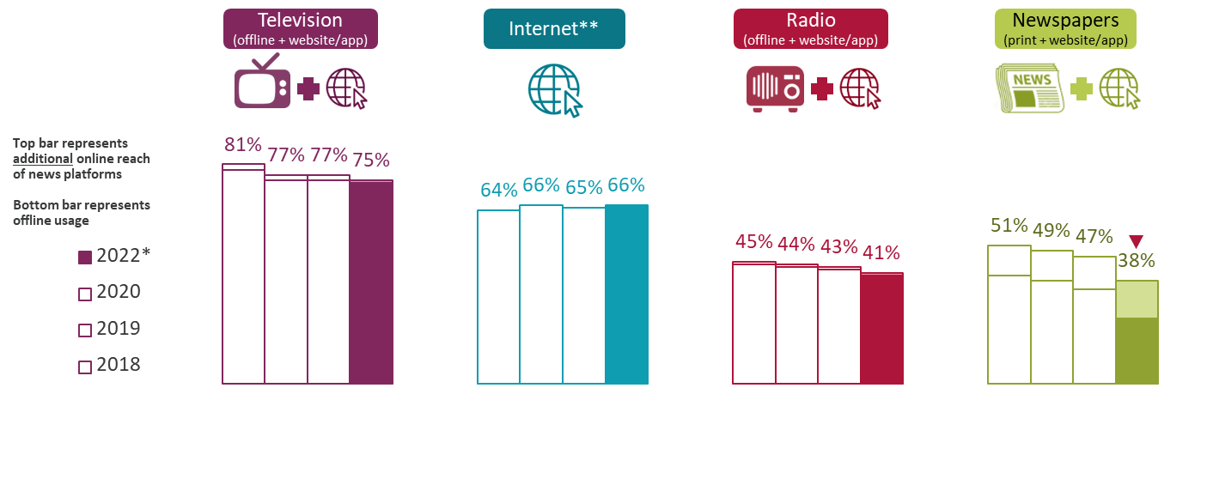
Use of main platforms for news nowadays All adults 16+
TV and Internet remain the most-used platforms for news nowadays. Print and online newspapers, and radio, both reach 4 in 10 adults
Figure 2.1
In the internet section of the questionnaire, we ask respondents ‘In which types of ways do you access and use news through internet sources nowadays’. A possible answer here was ‘Watch TV news online’. Including respondents who selected this option, who didn’t originally say they used TV for news, brings the total for TV news (online or offline) to 75%.
Another option here was ‘Listen to radio news online’, including those who selected this option, who hadn’t originally said they use radio for news, brings the total for radio (online or offline) to 41%.
Combining mentions of reading news in printed newspapers and via newspaper websites/apps, brings the total for newspapers (online or offline) to 38%.
Source: Ofcom News Consumption Survey 2022 – COMBINED F2F & ONLINE sample
Question: C1. Which of the following platforms do you use for news nowadays? Base: All Adults 16+ - 2022 W2*=2792, 2020=4576, 2019=4691, 2018=4618
*2022 W1, and 2021, data not shown because face-to-face fieldwork was not possible during Covid-19 pandemic
**Internet figures include use of social media, podcasts and all other websites/apps accessed via any device (NB: podcasts were included for the first time in 2020)
Green/red triangles indicate statistically significant differences between 2022 and 2020 (at 99% confidence level)

Slide 13
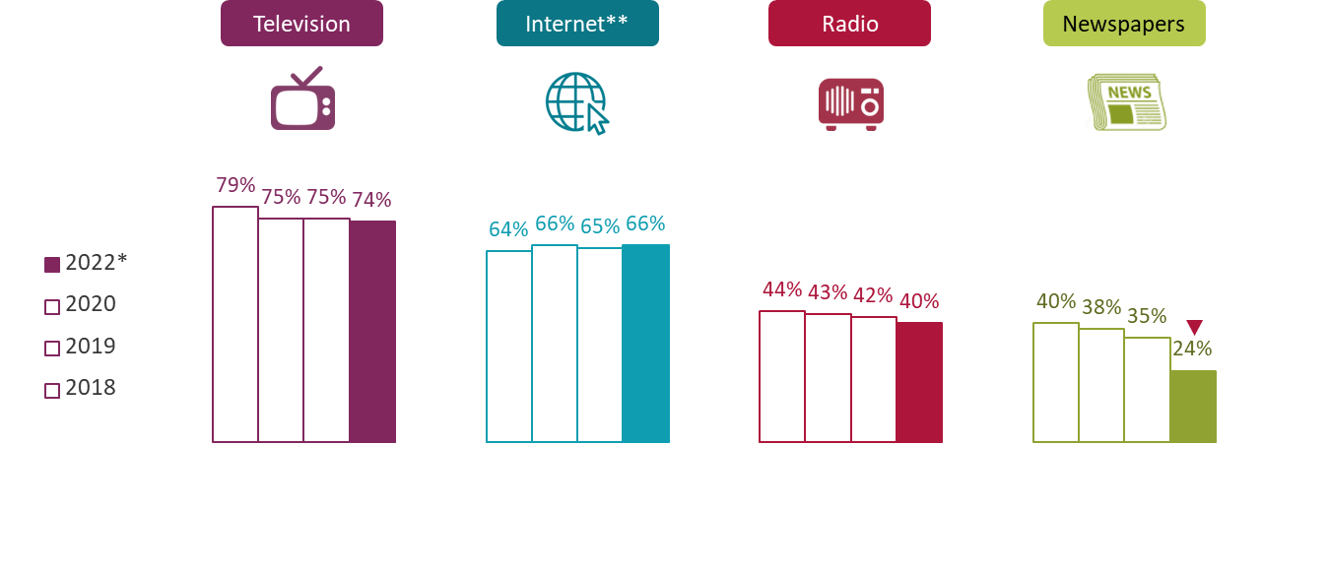
Use of main platforms for news nowadays All adults 16+
Reach of print newspapers has decreased substantially since 2020, with the trend seen pre-pandemic possibly accelerating
Figure 2.2
Source: Ofcom News Consumption Survey 2022 – COMBINED F2F & ONLINE sample
Question: C1. Which of the following platforms do you use for news nowadays? Base: All Adults 16+ - 2022 W2*=2792, 2020=4576, 2019=4691, 2018=4618
*2022 W1, and 2021, data not shown because face-to-face fieldwork was not possible during Covid-19 pandemic
**Internet figures include use of social media, podcasts and all other websites/apps accessed via any device (NB: podcasts were included for the first time in 2020)
Green/red triangles indicate statistically significant differences between 2022 and 2020 (at 99% confidence level)

Slide 14
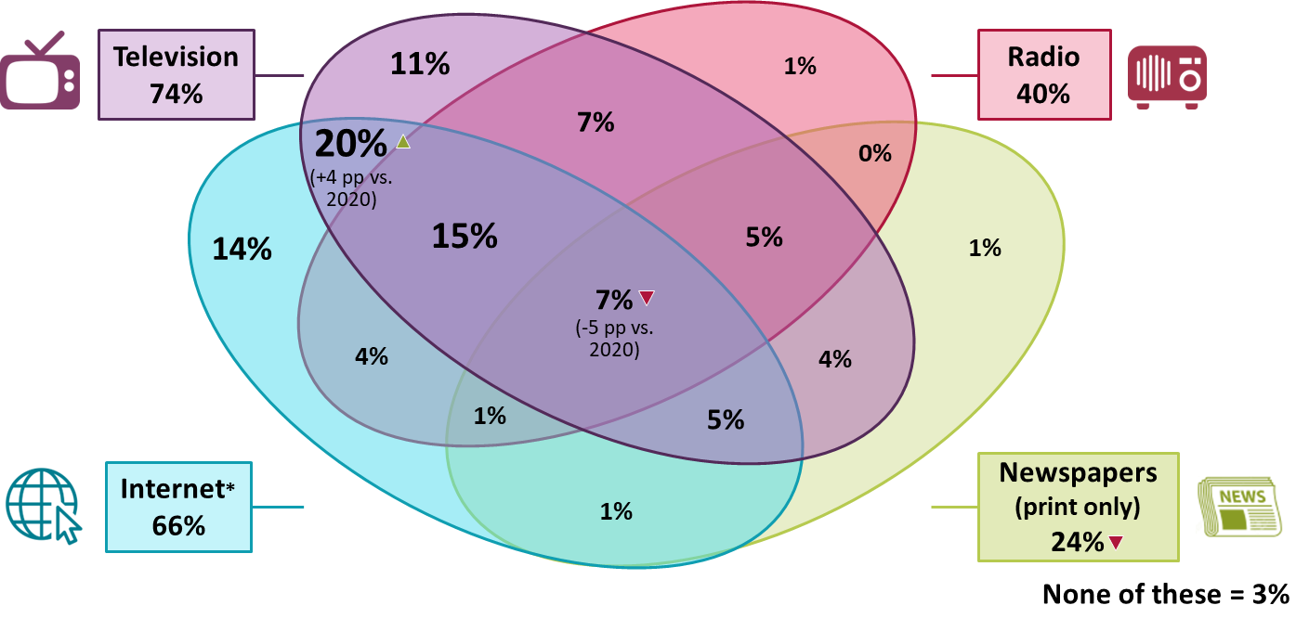
Crossover use of four main platforms for news nowadays 2022* All adults 16+
A smaller proportion of adults claim to use all four of the main platforms for news nowadays (driven by the decrease in print)
Figure 2.3
Source: Ofcom News Consumption Survey 2022 – COMBINED F2F & ONLINE sample
Question: C1. Which of the following platforms do you use for news nowadays? Base: All Adults 16+ - 2022 W2*=2792
*2022 W1, and 2021, data not shown because face-to-face fieldwork was not possible during Covid-19 pandemic
*Internet figures include use of social media, podcasts and all other websites/apps accessed via any device
Green/red triangles indicate statistically significant differences between 2022 and 2020 (at 99% confidence level)

Slide 15
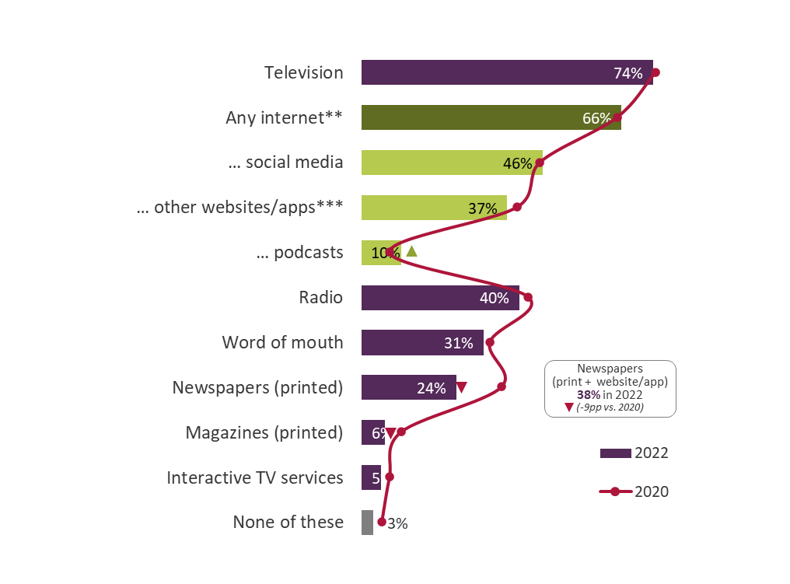
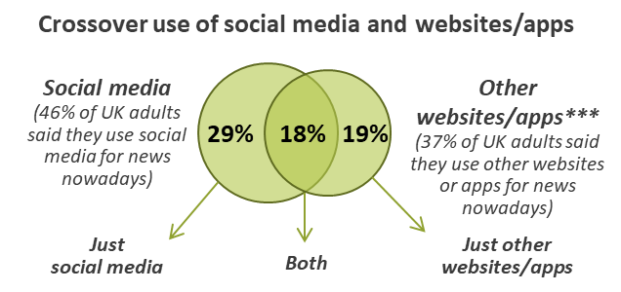
All platforms used for news nowadays 2022* All adults 16+
Use of podcasts has increased since 2020, while use of printed magazines has decreased
Figure 2.4
Source: Ofcom News Consumption Survey 2022 – COMBINED F2F & ONLINE sample
Question: C1. Which of the following platforms do you use for news nowadays? Base: All Adults 16+ - 2022 W2*=2792, 2020=4576
*2022 W1, and 2021, data not shown because face-to-face fieldwork was not possible during Covid-19 pandemic
**Internet figures include use of social media, podcasts and all other websites/apps accessed via any device
***Other websites/apps includes any non-social media internet source (excluding podcasts)
Green/red triangles indicate statistically significant differences between 2022 and 2020 (at 99% confidence level)

Slide 16
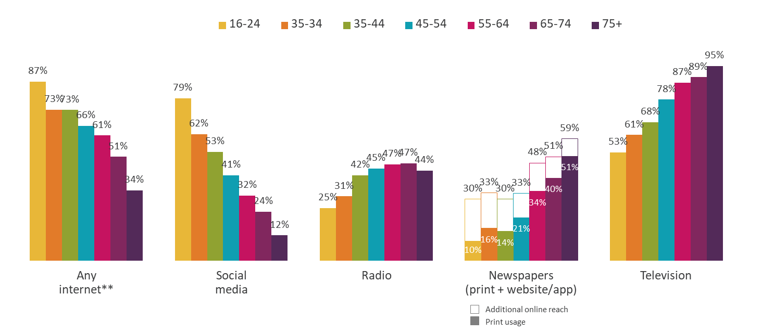
Use of main platforms for news nowadays 2022* – by age All adults 16+
Younger age groups are more likely to use the internet and social media for news. Reach of newspapers doubles for groups aged 16-44 when online newspapers are included
Figure 2.5
Source: Ofcom News Consumption Survey 2022 – COMBINED F2F & ONLINE sample
Question: C1. Which of the following platforms do you use for news nowadays?
Base: All Adults 16+ 2022 W2* – Aged 16-24=442, 25-34=385, 35-44=520, 45-54=463, 55-64=412, 65-74=346, 75+=223
*2022 W1 data not shown because face-to-face fieldwork was not possible during Covid-19 pandemic
**Internet figures include use of social media, podcasts and all other websites/apps accessed via any device

Slide 17
Cross-platform news

Slide 18
Top 20 news sources – trend data % of all adults 16+ using each source for news nowadays
BBC One is the most-used news source across platforms. Use of ITV and Google (search) have both decreased since 2020, while YouTube reach is up
Figure 3.1
 | 2018 | 2019 | 2020 | 2022*
BBC One | 62% | 58% | 56% | 53%
ITV/ITV WALES/UTV/STV | 41% | 40% | 41% | 35%
Facebook | 33% | 35% | 34% | 32%
BBC News Channel | 26% | 23% | 21% | 24%
Sky News Channel | 24% | 23% | 25% | 23%
BBC website/app** | 23% | 25% | 23% | 23%
Twitter | 14% | 16% | 17% | 17%
Channel 4 | 18% | 17% | 18% | 17%
Instagram | 9% | 13% | 14% | 16%
Daily Mail/Mail on Sunday | 18% | 18% | 17% | 15%
WhatsApp | 10% | 14% | 13% | 14%
Google (search engine) | 17% | 19% | 15% | 12%
BBC Two | 14% | 11% | 11% | 11%
BBC Radio 2 | 12% | 12% | 12% | 11%
The Guardian/Observer | 11% | 11% | 10% | 10%
BBC Radio 4 | 10% | 9% | 9% | 9%
Channel 5 | 10% | 10% | 8% | 8%
BBC Radio 1 | 9% | 9% | 9% | 8%
YouTube website/app | 5% | 6% | 6% | 8%
Sky News website/app | 6% | 7% | 8% | 7%
TV channel
Newspaper (print + website/app)
Radio station
Social media
Other website/app
Source: Ofcom News Consumption Survey 2022 – COMBINED F2F & ONLINE sample
Question: D2a-D8a. Thinking specifically about <platform>, which of the following do you use for news nowadays?
Base: All Adults 16+ - 2022 W2*=2792, 2020=4576, 2019=4691, 2018=4618
*2022 W1, and 2021, data not shown because face-to-face fieldwork was not possible during Covid-19 pandemic. **Includes Welsh language version
Green/red triangles indicate statistically significant differences between 2022 and 2020 (at 99% confidence level)

Slide 19
Top 10 news sources used by age % of all adults using each source for news nowadays
There is significant variation in the top 10 sources used by different age groups
Figure 3.2
All adults | Aged 16+
BBC One | 53%
ITV/ITV WALES/UTV/STV | 35%
Facebook | 32%
BBC News Channel | 24%
Sky News Channel | 23%
BBC website/app** | 23%
Twitter | 17%
Channel 4 | 17%
Instagram | 16%
Daily Mail/Mail on Sunday | 15%
Young adults | 16-24
Instagram | 46%
Facebook | 40%
BBC One | 36%
Twitter | 35%
BBC website/app** | 29%
TikTok | 27%
WhatsApp | 23%
ITV/ITV WALES/UTV/STV | 20%
Snapchat | 19%
BBC News Channel | 17%
Older adults | 65+
BBC One | 72%
ITV/ITV WALES/UTV/STV | 47%
BBC News Channel | 29%
Daily Mail/Mail on Sunday | 20%
Sky News Channel | 19%
BBC website/app** | 19%
Channel 4 | 19%
BBC Radio 4 | 19%
BBC Two | 16%
Local newspapers | 14%
TV channel
Newspaper (print + website/app)
Radio station
Social media
Other website/app
Source: Ofcom News Consumption Survey 2022 – COMBINED F2F & ONLINE sample
Question: D2a-D8a. Thinking specifically about <platform>, which of the following do you use for news nowadays?
Base: All Adults 16+ 2022 W2* - Total=2792, Aged 16-24=442, Aged 65+=569
*2022 W1, and 2021, data not shown because face-to-face fieldwork was not possible during Covid-19 pandemic
**Includes Welsh language version

Slide 20
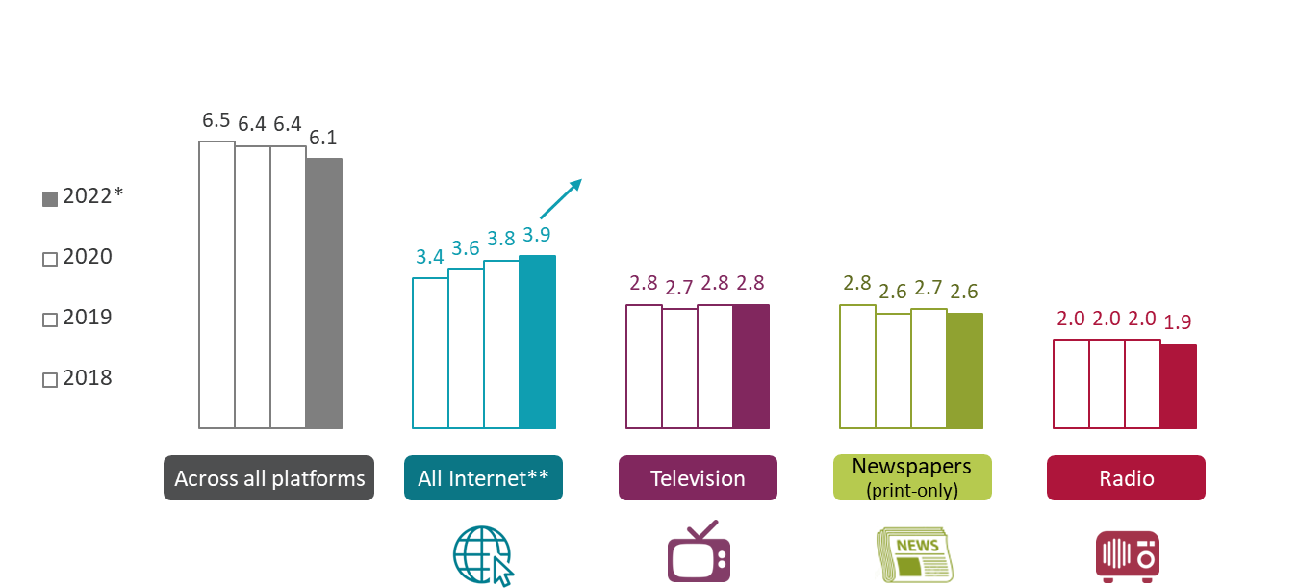
Average number of individual news sources used nowadays by platform All adults 16+/All using each platform for news
In 2022, adults aged 16+ use an average of 6.1 individual news sources across all platforms
Figure 3.3
 | Ave number of sources used
 | 2022* | 2020
Social media | 2.3 | 2.2
Podcasts | 2.0 | 2.0
Other internet (excl podcasts) | 3.7 | 3.6
Source: Ofcom News Consumption Survey 2022 – COMBINED F2F & ONLINE sample
Question: D2a-D8a. Thinking specifically about <platform>, which of the following do you use for news nowadays?
Base: All Adults 16+ 2022 W2* – Total=2792 / All using each platform for news 2022 W2* – All internet=1858, TV=2103, Newspapers=707, Radio=1176
*2022 W1, and 2021, data not shown because face-to-face fieldwork was not possible during Covid-19 pandemic
**All internet is the sum of social media, podcasts and all other websites/apps
Green/red triangles indicate statistically significant differences between 2022 and 2020 (at 99% confidence level)

Slide 21
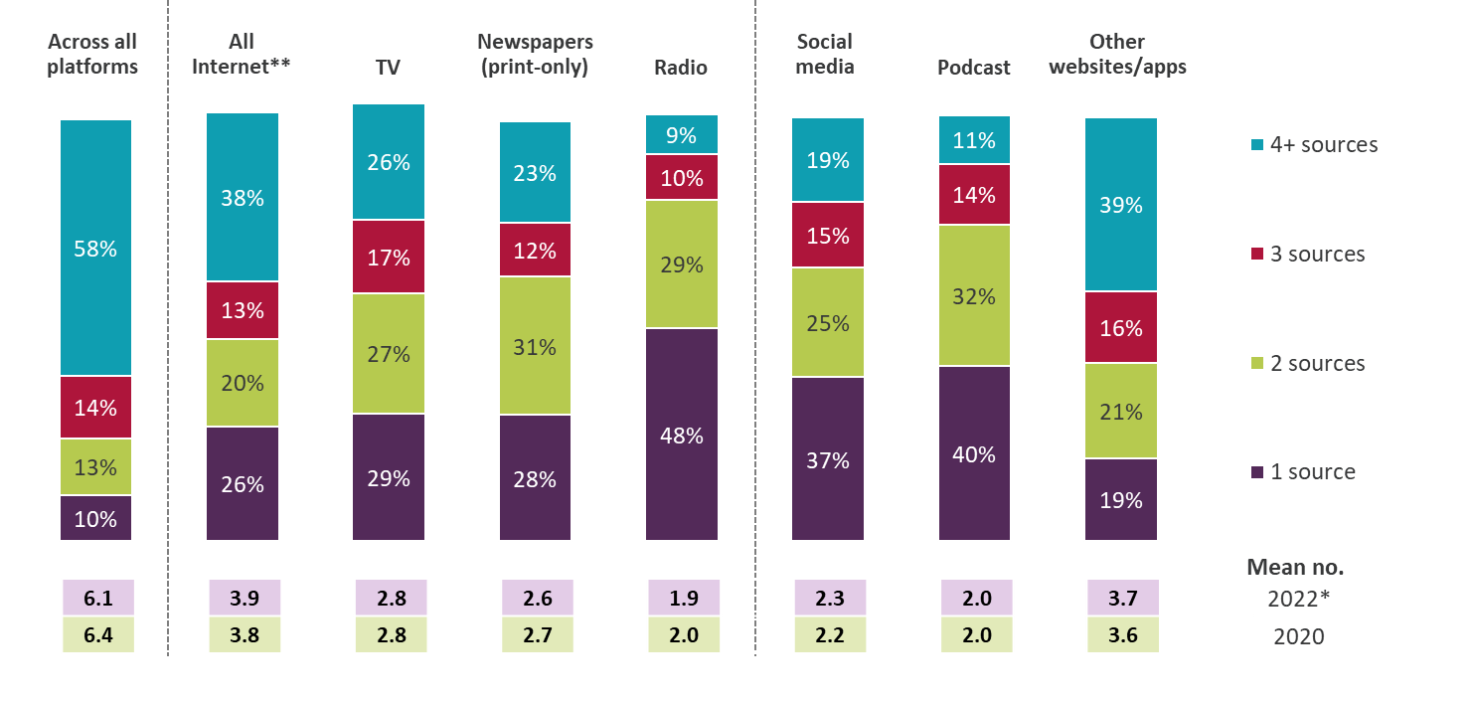
Number of individual sources used 2022* - by platform All adults 16+/All using each platform for news
As in previous years, other website/app news users use the highest number of individual news sources
Figure 3.4
Source: Ofcom News Consumption Survey 2022 – COMBINED F2F & ONLINE sample
Question: D2a-D8a. Thinking specifically about <platform>, which of the following do you use for news nowadays? Base: All Adults 16+ 2022 W2* – Total=2792 / All using each platform for news 2022 W2* – All internet=1858, TV=2103, Newspapers=707, Radio=1176, Social media=1365, Podcasts=286, Other websites/apps=1021
*2022 W1, and 2021, data not shown because face-to-face fieldwork was not possible during Covid-19 pandemic. **All internet is the sum of social media, podcasts and all other websites/apps. Note: Columns do not sum to 100% as some respondents did not name specific sources within a platform (zero sources)
Green/red triangles indicate statistically significant differences between 2022 and 2020 (at 99% confidence level)

Slide 22
Cross-platform retail providers used for news nowadays 2022* All adults 16+ using TV/Newspapers/Radio/Internet/Magazines for news
The BBC has the highest cross-platform audience reach, followed by Meta, ITV and Sky
Figure 3.5
Intermediaries
Source: Ofcom News Consumption Survey 2022 – COMBINED F2F & ONLINE sample
Question: D2a-D8a. Thinking specifically about <platform>, which of the following do you use for news nowadays?
Base: All adults 16+ using TV/Newspapers/Radio/Internet/Magazines for news - 2022 W2*=2690
*2022 W1 data not shown because face-to-face fieldwork was not possible during Covid-19 pandemic
National World plc** formerly JPI Media. Meta*** = Facebook + Instagram + WhatsApp. Google**** = Google News + Google + YouTube
The information included in this chart is based on the most up to date information we have

Slide 23
Single most important news source All adults 16+ using TV/Newspapers/Radio/Internet/Magazine for news
Compared to 2020, fewer adults now nominate ITV as their most important source, while more nominate the BBC News Channel
Figure 3.6
Source: Ofcom News Consumption Survey 2022 – COMBINED F2F & ONLINE sample
Question: E1a. Looking at all the sources of news you have just said that you use, which one is most important to you?
Base: All adults 16+ specifying at least one source for news – 2022 W2*=2665, 2020=4314, 2019=4492, 2018=4463
*2022 W1, and 2021, data not shown because face-to-face fieldwork was not possible during Covid-19 pandemic
Only sources with an incidence of 2%+ in 2022 are shown
Green/red triangles indicate statistically significant differences between 2022 and 2020 (at 99% confidence level)

Slide 24
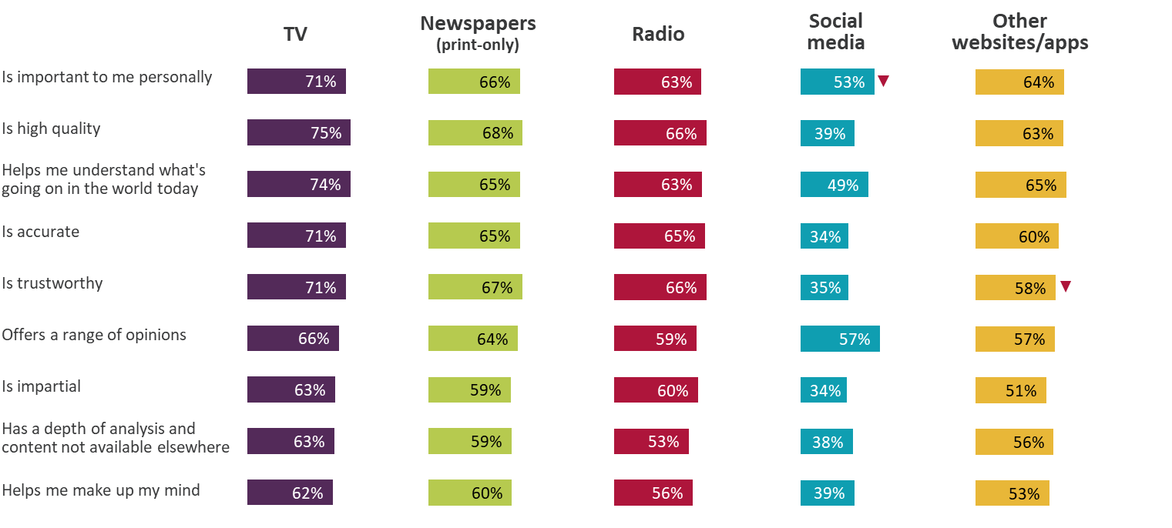
Attributes of news platforms – 2022* % of ratings from regular users who rated source highly (7-10)
When rated by their users on measures such as importance and trustworthiness, the main news platforms’ ratings are largely in line with 2020, although social media sees a lower ‘importance’ score this year
Figure 3.7
Source: Ofcom News Consumption Survey 2022 – COMBINED F2F & ONLINE sample
Question: E2. How important is <BRAND> as a source of news to you personally? E3. And to what extent do you think the following statements apply to <BRAND> as a news source? Answer using a scale of 1 to 10. Base: All ratings by those using each platform for news at least weekly (every 2-3 wks for weekly newspapers/mags) 2022 W2* – TV=4557, Newspapers=1407, Radio=1463, Social media=2227, Other websites/apps=2394
*2022 W1, and 2021, data not shown because face-to-face fieldwork was not possible during Covid-19 pandemic
Green/red triangles indicate statistically significant differences between 2022 and 2020 (at 99% confidence level)

Slide 25
News consumption via television

Slide 26
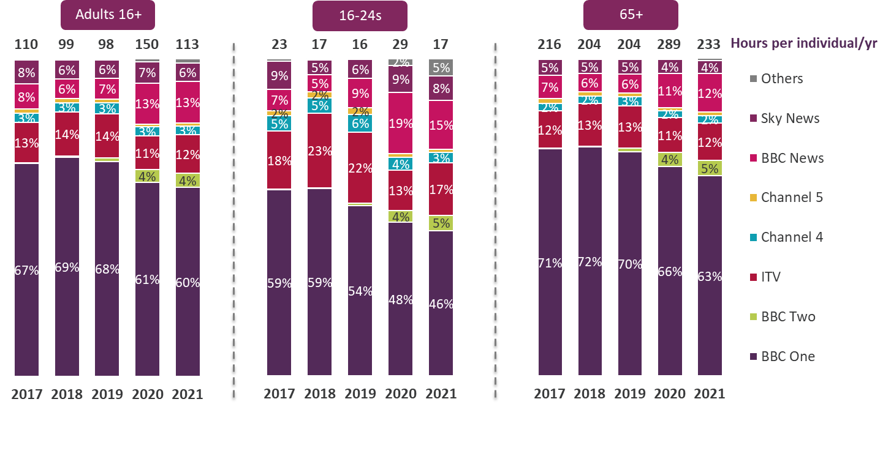
Proportion of national/international news viewing hours by channel group – 2017-21
Overall, adults watched an average of 113 hours in 2021, with most of this news viewing through BBC One. Those aged 65+ spent much more time watching news than 16-24s (233 hours vs. 17 hours for 16-24s in 2021)
Figure 4.1
Source: BARB, Network. Network programming based on 4+ area filter. Genre = national/international news.
Channels include their HD and +1 variants. Others = all other channels that showed national/international news that are not any of the listed channels above.

Slide 27
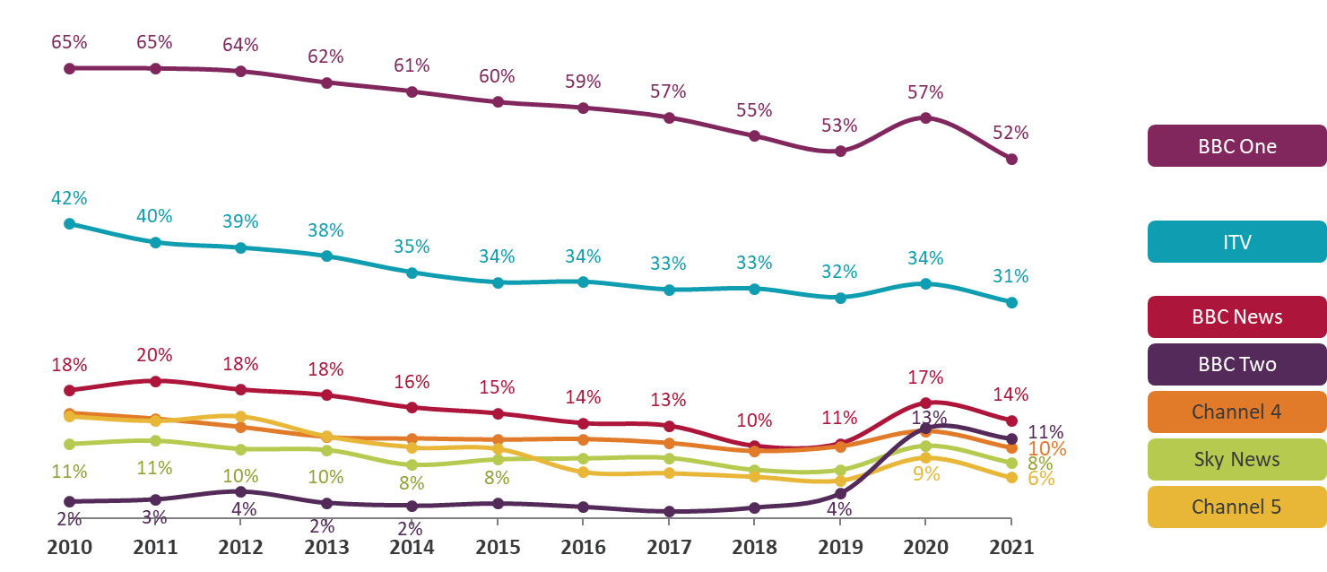
Average weekly reach of national/international news by channel - 2010 to 2021 All adults 16+
BARB data shows that people turned to TV channels for news at the start of the pandemic in 2020 and then turned away as it progressed (in 2021)
Figure 4.2
Source: BARB, Network. Network programming based on 4+ area filter. Genre = national/international news.
Channels include their HD and +1 variants. Reach criteria = 3 consecutive minutes. Full weeks used for the correct calculation of weekly averages

Slide 28
Top 20 news sources – Online Sample Only trend comparison* % of all adults 16+ (online sample only) using each source for news nowadays
News Consumption Survey data, among the online sample, appears to corroborate some of the decreases seen in BARB
Figure 4.3
 | 2020 | 2021 | 2022
BBC One | 62% | 62% | 56%
ITV/ITV WALES/UTV/STV | 49% | 46% | 43%
Facebook | 40% | 36% | 35%
BBC website/app | 32% | 31% | 30%
BBC News Channel | 30% | 31% | 26%
Sky News Channel | 28% | 30% | 25%
Channel 4 | 26% | 24% | 24%
Twitter | 24% | 24% | 23%
Instagram | 18% | 19% | 21%
Daily Mail/Mail on Sunday | 23% | 22% | 20%
WhatsApp | 17% | 16% | 17%
Google (search engine) | 19% | 17% | 16%
The Guardian/Observer | 16% | 16% | 15%
BBC Two | 15% | 16% | 14%
BBC Radio 2 | 16% | 13% | 14%
Channel 5 | 11% | 12% | 12%
The Sun/Sun on Sunday | 14% | 12% | 11%
BBC Radio 4 | 12% | 11% | 11%
Sky News website/app | 11% | 12% | 11%
BBC Radio 1 | 13% | 11% | 10%
TV channel
Newspaper (print + website/app)
Radio station
Social media
Other website/app
Source: Ofcom News Consumption Survey 2022 – ONLINE SAMPLE ONLY
Question: D2a-D8a. Thinking specifically about <platform>, which of the following do you use for news nowadays?
Base: All Adults 16+ (online sample only) - 2022=3423, 2021=3327, 2020=2510
Green/red triangles indicate statistically significant differences between 2022 and 2021 (at 95% confidence level)
*Online sample only used to show trend between 2021 and 2022
ONLINE SAMPLE ONLY

Slide 29
TV channels used for news nowadays All using TV for news
Among the adults that use TV for news, BBC One remains the most-used channel.
Figure 4.4
Any BBC TV
2022* | 84%
2020 | 83%
2019 | 85%
2018 | 87%
Source: Ofcom News Consumption Survey 2022 – COMBINED F2F & ONLINE sample
Question: D2a. Thinking specifically about television, which of the following do you use for news nowadays?
Base: All using TV for news – 2022 W2*=2103, 2020=3456, 2019=3556, 2018=3731
*2022 W1, and 2021, data not shown because face-to-face fieldwork was not possible during Covid-19 pandemic
Only sources with an incidence of >5% in 2022 are shown **GB News added in 2022
Green/red triangles indicate statistically significant differences between 2022 and 2020 (at 99% confidence level)

Slide 30
Attributes of TV sources (1) – 2022* % of regular users rating each source highly (7-10)
The Sky News Channel and CNN continue to have high ratings across the majority of the attributes. User attitudes are generally consistent with 2020.
Figure 4.5
 | BBC TV | ITV | Sky News | Channel 4 | Channel 5 | CNN | Al Jazeera | GB News**
 | 1671 | 1042 | 657 | 429 | 205 | 137 | 126 | 124
Is important to me personally | 76% | 66% | 78% | 62% | 49% | 79% | 77% | 60%
Is high quality | 78% | 72% | 83% | 68% | 59% | 85% | 67% | 59%
Helps me understand what's going on in the world today | 78% | 70% | 79% | 70% | 61% | 86% | 70% | 64%
Is accurate | 74% | 71% | 75% | 64% | 60% | 85% | 57% | 62%
Is trustworthy | 73% | 70% | 75% | 66% | 59% | 83% | 60% | 67%
Offers a range of opinions | 65% | 64% | 76% | 62% | 52% | 84% | 58% | 69%
Is impartial | 62% | 64% | 72% | 60% | 53% | 79% | 59% | 50%
Has a depth of analysis and content not available elsewhere | 64% | 54% | 73% | 62% | 49% | 84% | 63% | 64%
Helps me make up my mind | 61% | 59% | 70% | 58% | 48% | 84% | 59% | 57%
Source: Ofcom News Consumption Survey 2022 – COMBINED F2F & ONLINE sample
Question: E2. How important is <BRAND> as a source of news to you personally? E3. And to what extent do you think the following statements apply to <BRAND> as a news source? Answer using a scale of 1 to 10
Base: All using each source for news at least weekly 2022 W2* – bases shown above
*2022 W1, and 2021, data not shown because face-to-face fieldwork was not possible during Covid-19 pandemic **GB News added in 2022
Green/red triangles indicate statistically significant differences between 2022 and 2020 (at 99% confidence level)

Slide 31
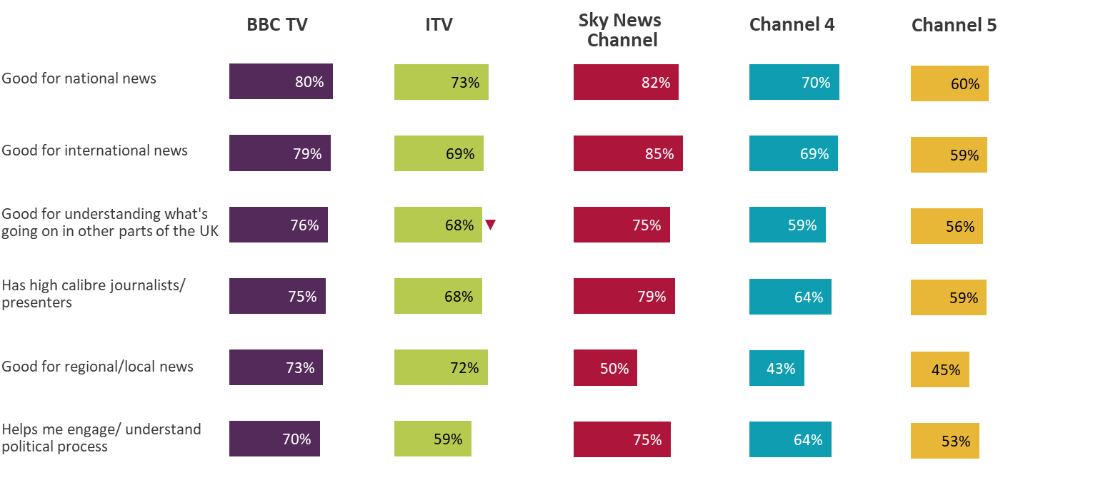
Attributes of TV sources (2) – 2022* % of regular users rating each source highly (7-10)
Users of Sky News continue to give better ratings for ‘international news’, whereas users of ITV and BBC provide better scores for ‘regional/local’ news. ITV’s rating for ‘what's going on in other parts of the UK’ has decreased
Figure 4.6
Source: Ofcom News Consumption Survey 2022 – COMBINED F2F & ONLINE sample
Question: E2. How important is <BRAND> as a source of news to you personally? E3. And to what extent do you think the following statements apply to <BRAND> as a news source? Answer using a scale of 1 to 10
Base: All using each source for news at least weekly 2022 W2* – BBC TV=1671, ITV=1042, Sky News Channel=657, Channel 4=429, Channel 5=205
*2022 W1, and 2021, data not shown because face-to-face fieldwork was not possible during Covid-19 pandemic
Green/red triangles indicate statistically significant differences between 2022 and 2020 (at 99% confidence level)

Slide 32
News consumption via radio

Slide 33
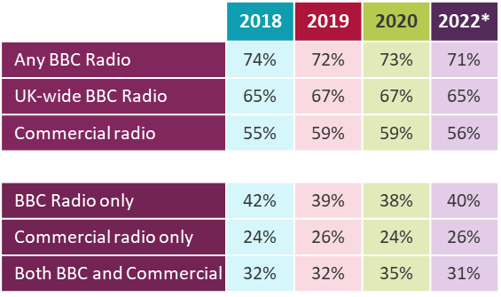
Radio stations used for news nowadays All using radio for news
Among the adults that use radio for news, 7 in 10 claim to use a BBC station. Longer term, reach of Capital, Heart and BBC local radio in England for news appears to be decreasing
Figure 5.1
Source: Ofcom News Consumption Survey 2022 – COMBINED F2F & ONLINE sample
Question: D6a. Thinking specifically about radio stations, which of the following do you use for news nowadays?
Base: All using radio for news – 2022 W2*=1176, 2020=1975, 2019=2043, 2018=2096. Only sources with an incidence of >5% in 2022 are shown
*2022 W1, and 2021, data not shown because face-to-face fieldwork was not possible during Covid-19 pandemic
Green/red triangles indicate statistically significant differences between 2022 and 2020 (at 99% confidence level)
Note: Radio stations include short news bulletins at the start of each hour which aren't measured through the industry metric, RAJAR. Our survey helps us understand the role radio plays in news consumption.

Slide 34
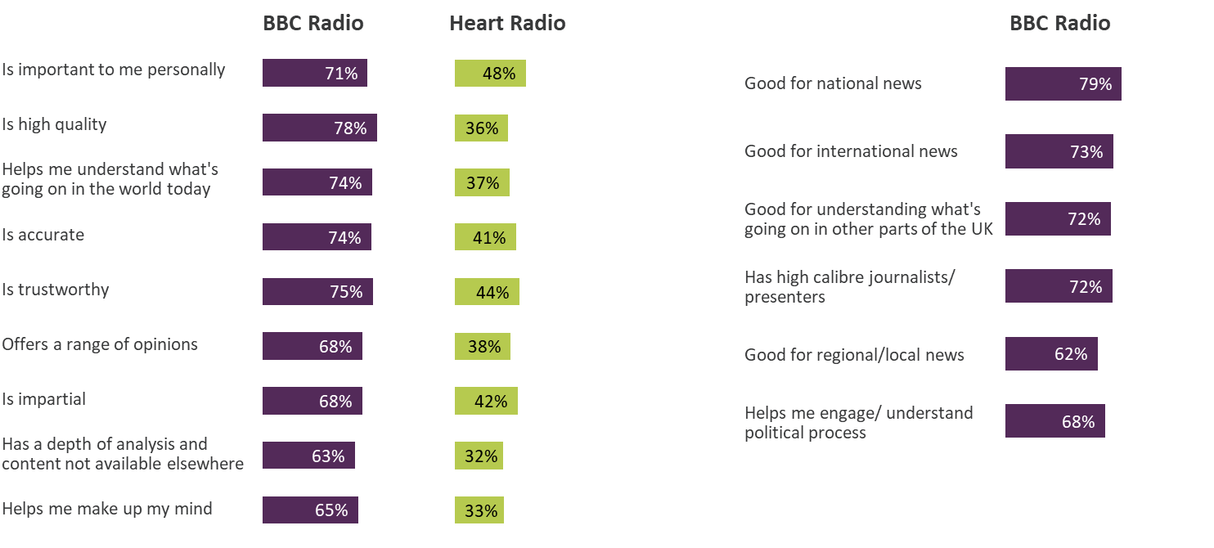
Attributes of Radio sources – 2022* % of regular users rating each source highly (7-10)
BBC listeners generally give high scores across attributes
Figure 5.2
Source: Ofcom News Consumption Survey 2022 – COMBINED F2F & ONLINE sample
Question: E2. How important is <BRAND> as a source of news to you personally? E3. And to what extent do you think the following statements apply to <BRAND> as a news source? Answer using a scale of 1 to 10
Base: All using each source for news at least weekly 2022 W2* – BBC Radio=790, Heart=116
*2022 W1, and 2021, data not shown because face-to-face fieldwork was not possible during Covid-19 pandemic
Green/red triangles indicate statistically significant differences between 2022 and 2020 (at 99% confidence level)

Slide 35
News consumption via newspapers

Slide 36
Daily newspapers used for news nowadays (print only) All using printed newspapers for news
Among the adults who claim to consume news through print, the reach of free newspapers has decreased since 2020
Figure 6.1
In total, 19% (27% in 2020) of print newspaper readers used daily ‘free-sheets’
Source: Ofcom News Consumption Survey 2022 – COMBINED F2F & ONLINE sample
Question: D3a. Thinking specifically about daily newspapers, which of the following do you use for news nowadays?
Base: All using print newspapers for news – 2022 W2*=707, 2020=1594, 2019=1741, 2018=1847
*2022 W1, and 2021, data not shown because face-to-face fieldwork was not possible during Covid-19 pandemic
Only sources with an incidence of >5% in 2022 are shown. Note: Daily free-sheets are the Metro and the Evening Standard
Green/red triangles indicate statistically significant differences between 2022 and 2020 (at 99% confidence level)

Slide 37
Sunday newspapers used for news nowadays (print only) All using printed newspapers for news
The Mail on Sunday remains the most read Sunday title. The Sun on Sunday has seen a significant decrease since 2020
Figure 6.2
In total, 3% (3% in 2020) of print newspaper readers used free local weekly newspapers
Source: Ofcom News Consumption Survey 2022 – COMBINED F2F & ONLINE sample
Question: D4a. Thinking specifically about weekly newspapers, which of the following do you use for news nowadays?
Base: All using print newspapers for news – 2022 W2*=707, 2020=1594, 2019=1741, 2018=1847
*2022 W1, and 2021, data not shown because face-to-face fieldwork was not possible during Covid-19 pandemic
Only sources with an incidence of >5% in 2022 are shown
Green/red triangles indicate statistically significant differences between 2022 and 2020 (at 99% confidence level)

Slide 38
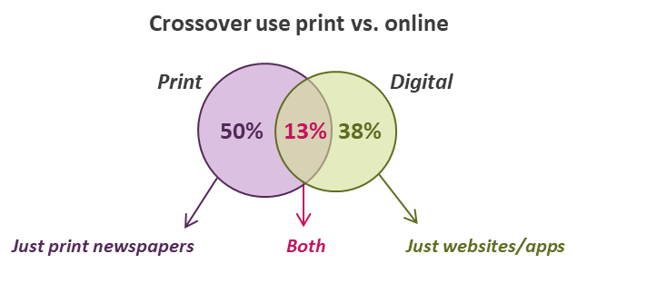
Print vs. digital newspaper readership 2022* All using newspapers (print + website/app) for news
The Daily Mail/Mail on Sunday remains the most widely-read news title overall, whilst The Guardian/Observer and Daily Mail/Mail on Sunday are the most widely-read digital titles
Figure 6.3
Source: Ofcom News Consumption Survey 2021 - COMBINED F2F & ONLINE sample
Question: D3a/D4a. Thinking specifically about daily/weekly newspapers, which of the following do you use for news nowadays?
D8a. Thinking specifically about the internet, which of the following do you use for news nowadays?
Base: All using newspapers (print + website/app) for news – 2022 W2*=1083
*2022 W1 data not shown because face-to-face fieldwork was not possible during Covid-19 pandemic

Slide 39
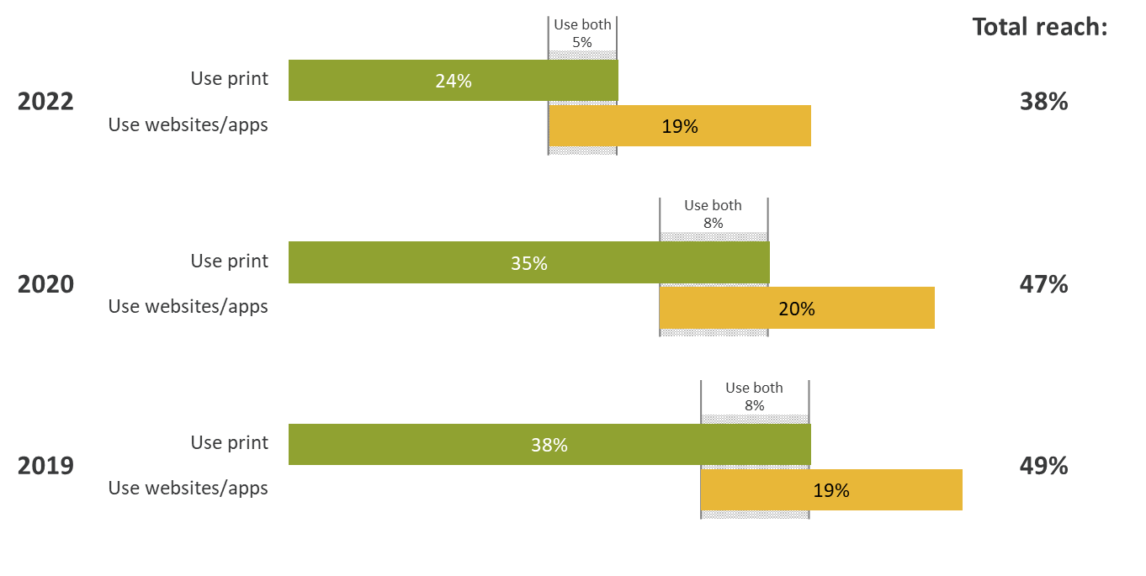
Crossover use of print and digital newspapers All adults 16+
While print newspaper reach decreases year on year, online newspaper reach remains steady but does not make up for print losses
Figure 6.4
Source: Ofcom News Consumption Survey 2022 – COMBINED F2F & ONLINE sample
Question: D3a/D4a. Thinking specifically about daily/weekly newspapers, which of the following do you use for news nowadays?
D8a. Thinking specifically about the internet, which of the following do you use for news nowadays?
Base: All Adults 16+ - 2022 W2*=2792, 2020=4576, 2019=4691
*2022 W1, and 2021, data not shown because face-to-face fieldwork was not possible during Covid-19 pandemic
Notes:
Rebased to total pop
Online reach staying steady
Newspaper generally declining

Slide 40
Attributes of Print Newspaper sources – 2022* % of regular users rating each source highly (7-10)
Readers of The Guardian/Observer and The Times/Sunday Times rate these papers comparatively highly for ‘high quality’, ‘range of opinions’, ‘helps me understand what's going on in the world today’, ‘accurate’ and ‘trustworthy’
Figure 6.5
 | Daily Mail/ Mail on Sunday | The Sun/ Sun on Sunday | The Times/ Sunday Times | The Guardian/ Observer | The Metro | Daily/ Sunday Mirror
 | 273 | 164 | 124 | 115 | 112 | 110
Is important to me personally | 63% | 62% | 72% | 77% | 52% | 70%
Is high quality | 66% | 48% | 83% | 82% | 51% | 70%
Helps me understand what's going on in the world today | 66% | 55% | 77% | 80% | 61% | 70%
Is accurate | 63% | 51% | 78% | 79% | 55% | 68%
Is trustworthy | 65% | 47% | 78% | 77% | 58% | 70%
Offers a range of opinions | 61% | 52% | 82% | 76% | 56% | 68%
Is impartial | 53% | 42% | 67% | 70% | 55% | 60%
Has a depth of analysis and content not available elsewhere | 59% | 46% | 76% | 74% | 38% | 57%
Helps me make up my mind | 56% | 50% | 70% | 73% | 44% | 69%
Source: Ofcom News Consumption Survey 2022 – COMBINED F2F & ONLINE sample
Question: E2. How important is <BRAND> as a source of news to you personally? E3. And to what extent do you think the following statements apply to <BRAND> as a news source? Answer using a scale of 1 to 10
Base: All using each source for news at least weekly (or every 2-3 weeks for weekly newspapers) 2022 W2* – bases shown above
*2022 W1, and 2021, data not shown because face-to-face fieldwork was not possible during Covid-19 pandemic
Green/red triangles indicate statistically significant differences between 2022 and 2020 (at 99% confidence level)

Slide 41
News consumption via social media

Slide 42
Top 21 news sources All adults 16+
TikTok has seen the largest increase in use of any news source between 2020 and 2022
Figure 7.1
 | 2018 | 2019 | 2020 | 2022*
BBC One | 62% | 58% | 56% | 53%
ITV/ITV WALES/UTV/STV | 41% | 40% | 41% | 35%
Facebook | 33% | 35% | 34% | 32%
BBC News Channel | 26% | 23% | 21% | 24%
Sky News Channel | 24% | 23% | 25% | 23%
BBC website/app** | 23% | 25% | 23% | 23%
Twitter | 14% | 16% | 17% | 17%
Channel 4 | 18% | 17% | 18% | 17%
Instagram | 9% | 13% | 14% | 16%
Daily Mail/Mail on Sunday | 18% | 18% | 17% | 15%
WhatsApp | 10% | 14% | 13% | 14%
Google (search engine) | 17% | 19% | 15% | 12%
BBC Two | 14% | 11% | 11% | 11%
BBC Radio 2 | 12% | 12% | 12% | 11%
The Guardian/Observer | 11% | 11% | 10% | 10%
BBC Radio 4 | 10% | 9% | 9% | 9%
Channel 5 | 10% | 10% | 8% | 8%
BBC Radio 1 | 9% | 9% | 9% | 8%
YouTube website/app | 5% | 6% | 6% | 8%
Sky News website/app | 6% | 7% | 8% | 7%
TikTok | - | - | 1% | 7%
TV channel
Newspaper (print + website/app)
Radio station
Social media
Other website/app
52% of TikTok users are aged 16-24
Source: Ofcom News Consumption Survey 2022 – COMBINED F2F & ONLINE sample
Question: D2a-D8a. Thinking specifically about <platform>, which of the following do you use for news nowadays?
Base: All Adults 16+ - 2022 W2*=2792, 2020=4576, 2019=4691, 2018=4618
*2022 W1, and 2021, data not shown because face-to-face fieldwork was not possible during Covid-19 pandemic. **Includes Welsh language version
Green/red triangles indicate statistically significant differences between 2022 and 2020 (at 99% confidence level)

Slide 43
Social media used for news nowadays All using social media for news
Among the adults who consume news via social media, Facebook is still most popular source. However, a smaller proportion claim to use Facebook and Snapchat for news in 2022, and more use TikTok
Figure 7.2
Source: Ofcom News Consumption Survey 2022 – COMBINED F2F & ONLINE sample
Question: D7a. Thinking specifically about social media (on any device), which of the following do you use for news nowadays?
Base: All using social media for news – 2022 W2*=1365, 2020=2143, 2019=2331, 2018=2058
*2022 W1, and 2021, data not shown because face-to-face fieldwork was not possible during Covid-19 pandemic
**TikTok added in 2020 Only sources with an incidence of >5% in 2022 are shown
Green/red triangles indicate statistically significant differences between 2022 and 2020 (at 99% confidence level)

Slide 44
Use of social media versus news organisations’ websites/apps All using social media for news
Those consuming news via social media remain more likely to get their online news from ‘posts’ rather than ‘directly from news organisations websites or apps’
Figure 7.3
Source: Ofcom News Consumption Survey 2022 – COMBINED F2F & ONLINE sample
Question: D15. And if you had to choose, which one of the following would you say is closest to the way you find out about news when you’re online?
Base: All using social media for news – 2022 W2*=1365, 2020=2143, 2019=2331, 2018=2058
*2022 W1, and 2021, data not shown because face-to-face fieldwork was not possible during Covid-19 pandemic
Green/red triangles indicate statistically significant differences between 2022 and 2020 (at 99% confidence level)

Slide 45
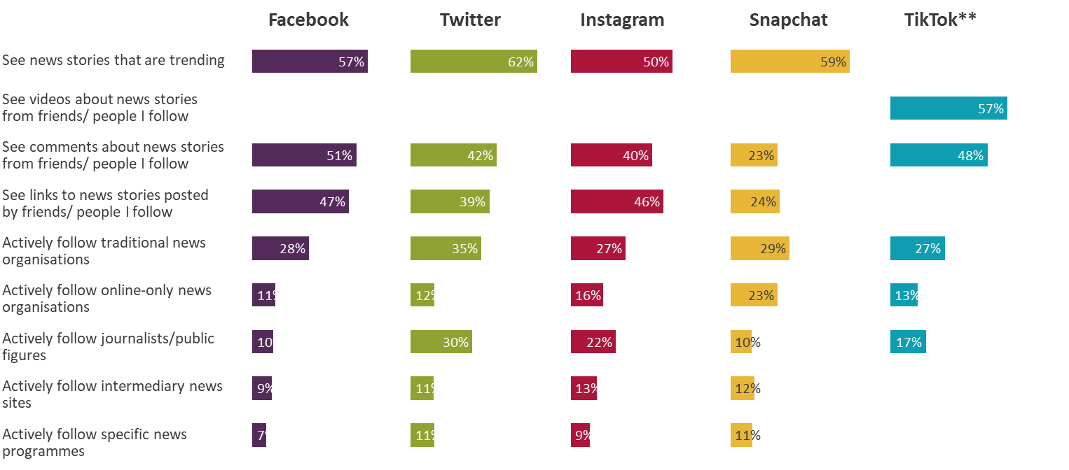
How news is accessed via social media 2022* All using each type of social media for news
News on social media sites is most likely to be accessed via ‘stories that are trending’, ‘seeing comments’ and ‘links to stories’. Almost 3 in 5 TikTok users ‘see videos about news stories’ from friends/people they follow
Figure 7.4
Source: Ofcom News Consumption Survey 2022 – COMBINED F2F & ONLINE sample
Question: D9. Earlier you mentioned that you get news from [social media site]. Which of the following do you do nowadays?
Base: All using each site for news 2022 W2* – Facebook=918, Twitter=530, Instagram=513, Snapchat=174, TikTok=239
*2022 W1, and 2021, data not shown because face-to-face fieldwork was not possible during Covid-19 pandemic **Different list of responses used for TikTok
Green/red triangles indicate statistically significant differences between 2022 and 2020 (at 99% confidence level)

Slide 46
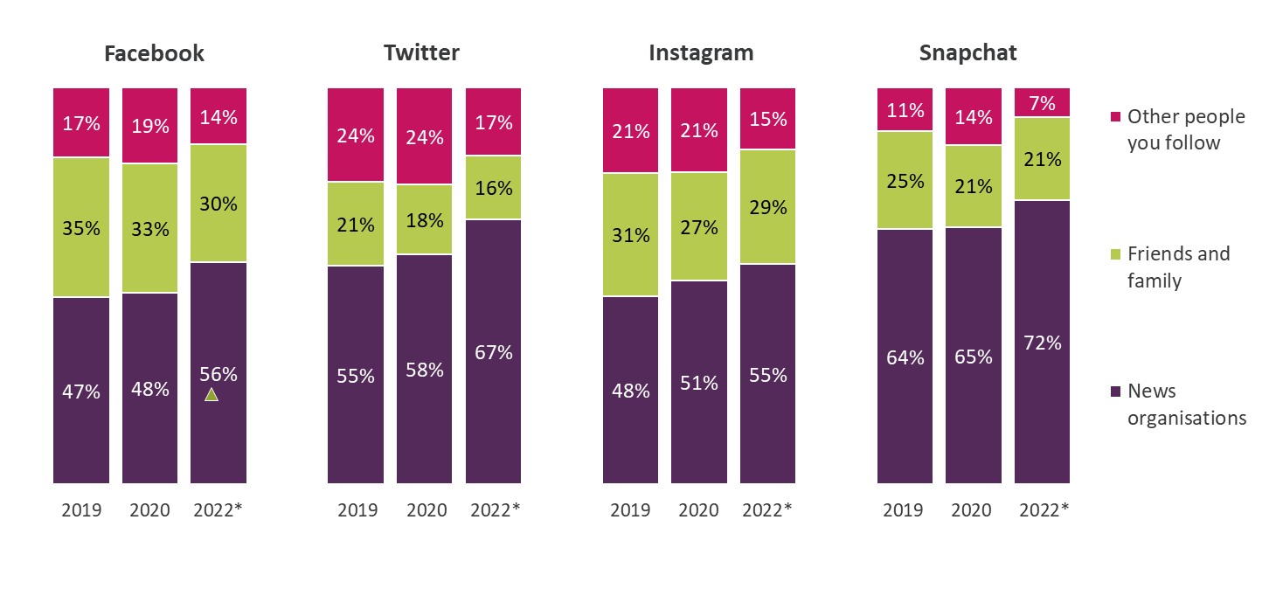
Proportion of news on social media accessed from each type of source All using each type of social media for news
Those consuming news on Facebook, Twitter, Instagram and Snapchat are more likely to do so from ‘news organisations’
Figure 7.5
Source: Ofcom News Consumption Survey 2022 - COMBINED F2F & ONLINE sample
Question: D10. Approximately what proportion of the news you get from [social media site] nowadays is from news organisations, friends and other people you follow?
Base: All using each site for news 2022 W2* – Facebook=910, Twitter=526, Instagram=509, Snapchat=168
*2022 W1, and 2021, data not shown because face-to-face fieldwork was not possible during Covid-19 pandemic
Green/red triangles indicate statistically significant differences between 2022 and 2020 (at 99% confidence level)

Slide 47
Proportion of news on TikTok accessed from each type of source All using TikTok for news
Those consuming news on TikTok are most likely to do so from ‘other people they follow’
Figure 7.6
Source: Ofcom News Consumption Survey 2022 - COMBINED F2F & ONLINE sample
Question: D10. Approximately what proportion of the news you get from TikTok nowadays is from news organisations, friends and other people you follow?
Base: All using TikTok for news 2022 W2* =232
*2022 W1 data not shown because face-to-face fieldwork was not possible during Covid-19 pandemic
D10 for TikTok not comparable to D10 for other social media due to question differences

Slide 48
News organisations followed on social media 2022* All accessing news organisations via each type of social media
Among those who follow news organisations on social media, BBC remains the most common source, generally followed by Sky News
Figure 7.7
Facebook
Twitter
Instagram
Snapchat**
TikTok**
BBC | 54% |  | ANY Public figure | 55% |  | ANY Public figure | 60% |  | ANY Public figure | 34% |  | ANY Public figure | 52%
ANY Public figure | 41% |  | BBC | 54% |  | BBC | 45% |  | ANY Journalist | 33% |  | ANY Journalist | 44%
ANY Journalist | 29% |  | ANY Journalist | 52% |  | ANY Journalist | 44% |  | BBC | 28% |  | BBC | 34%
Sky News | 27% |  | Sky News | 26% |  | Sky News | 22% |  | The Daily Mail | 25% |  | Sky News | 23%
The Daily Mail | 21% |  | Guardian/Observer | 17% |  | The LADbible | 14% |  | Sky News | 23% |  | ITV | 21%
ITV | 19% |  | ITV | 16% |  | BuzzFeed | 14% |  | The LADbible | 20% |  | The Daily Mail | 17%
The LADbible | 18% |  | The Daily Mail | 11% |  | YouTube | 14% |  | BuzzFeed | 19% |  | CNN | 16%
YouTube | 17% |  | Channel 4 | 11% |  | ITV | 13% |  | Channel 4 | 18% |  | BuzzFeed | 13%
BuzzFeed | 15% |  |  |  |  | The New York Times | 11% |  | The Sun | 17% |  | The Sun | 12%
Channel 4 | 14% |  |  |  |  | Channel 4 | 11% |  | YouTube | 14% |  | Guardian/Observer | 12%
Guardian/Observer | 13% |  |  |  |  | Guardian/Observer | 10% |  | Times/Sunday Times | 12% |  | The Daily Star | 11%
The Sun | 11% |  |  |  |  |  |  |  | Vice | 12% |  | Channel 4 | 10%
The Daily Mirror | 10% |  | ANY Public figure | 23% |  |  |  |  | The Daily Star | 10%
 |  |  | BBC | 21% |  |  |  |  | The Independent | 10%
 |  |  | ANY Journalist | 20% |  |  |  |  | The Metro | 10%
 |  |  | Sky News | 14% |  |  |  |  | Guardian/Observer | 10%
YouTube
Source: Ofcom News Consumption Survey 2022 – COMBINED F2F & ONLINE sample
Question: D12a/c. Which, if any, of the following news sources do you follow on [social media site]?
Base: All accessing news organisations via each type of social media 2022 W2* - Facebook=415, Twitter=306, Instagram=275, YouTube=298. ** Snapchat=88, TikTok=92 – low bases. *2022 W1, and 2021, data not shown because face-to-face fieldwork was not possible during Covid-19 pandemic
Only sources with an incidence of 10%+ on each type of social media are shown
Green/red triangles indicate statistically significant differences between 2022 and 2020 (at 99% confidence level)

Slide 49
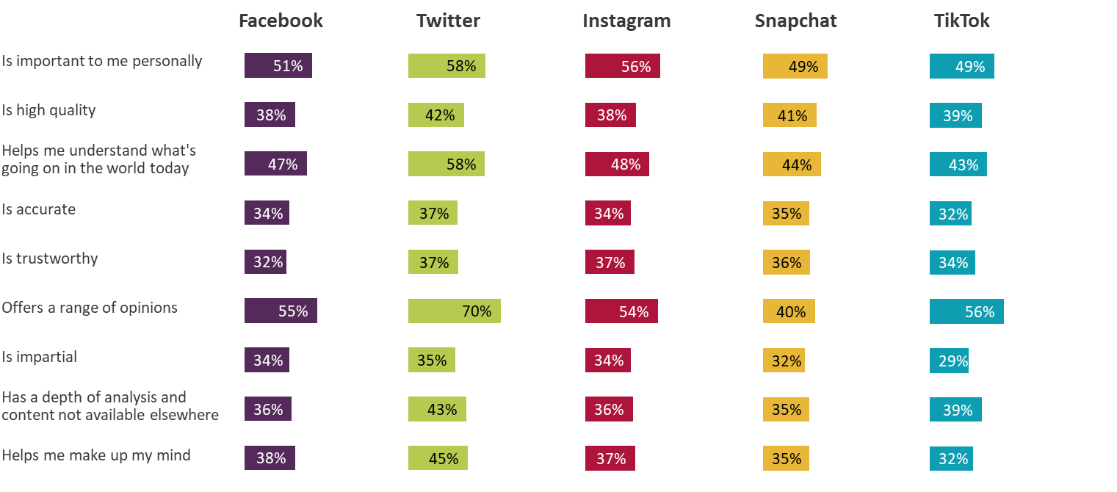
Attributes of Social Media – 2022* % of regular users rating each source highly (7-10)
Social media platforms continue to score relatively poorly across most attributes, but most do perform better on ‘offers a range of opinions’
Figure 7.8
Source: Ofcom News Consumption Survey 2022 – COMBINED F2F & ONLINE sample
Question: E2. How important is <BRAND> as a source of news to you personally? E3. And to what extent do you think the following statements apply to <BRAND> as a news source? Answer using a scale of 1 to 10
Base: All using each source for news at least weekly 2022 W2* – Facebook=872, Twitter=494, Instagram=486, Snapchat=157, TikTok=218
*2022 W1, and 2021, data not shown because face-to-face fieldwork was not possible during Covid-19 pandemic
Green/red triangles indicate statistically significant differences between 2022 and 2020 (at 99% confidence level)

Slide 50
News consumption via websites or apps*
*Websites/apps includes any non-social media internet source

Slide 51
Types of websites/apps used for news nowadays All adults 16+
Websites/apps of TV and radio companies are used by a quarter of adults for news nowadays, while search engines and websites/apps of newspapers are used by approximately 1 in 5
Figure 8.1
Source: Ofcom News Consumption Survey 2022 – COMBINED F2F & ONLINE sample
Question: C2. Which of the following do you use to get news?
Base: All Adults 16+ - 2022 W2*=2792, 2020=4576, 2019=4691, 2018=4618
*2022 W1, and 2021, data not shown because face-to-face fieldwork was not possible during Covid-19 pandemic **Video-sharing platforms added in 2022
Green/red triangles indicate statistically significant differences between 2022 and 2020 (at 99% confidence level)

Slide 52
Websites/apps used for news nowadays All using other websites/apps for news**
Among those using websites or apps for news, the BBC remains the most used, followed by Google (search). YouTube, Yahoo News and Apple News reach all have increased since 2020
Figure 8.2
 | 2018 | 2019 | 2020 | 2022*
BBC website/app**** | 63% | 65% | 60% | 62%
Google (search engine) | 46% | 51% | 39% | 34%
YouTube website/app | 13% | 15% | 15% | 21%
Sky News website/app | 17% | 20% | 20% | 20%
Guardian/Observer website/app | 17% | 18% | 18% | 19%
The Daily Mail website/app | 17% | 17% | 18% | 18%
Google News | 11% | 13% | 17% | 17%
Yahoo News website/app | 11% | 7% | 7% | 11%
Any local newspaper website/app | 11% | 10% | 10% | 10%
Apple News app | 6% | 6% | 5% | 10%
ITV/ITN*** website/app | 10% | 8% | 10% | 8%
MSN News website/app | 11% | 10% | 8% | 8%
CNN website/app | 7% | 4% | 5% | 8%
BuzzFeed website/app | 8% | 9% | 10% | 7%
Huffington Post website/app | 12% | 11% | 10% | 7%
The Telegraph website/app | 9% | 8% | 8% | 7%
The Independent website/app | 8% | 8% | 7% | 6%
The Sun website/app | 6% | 7% | 6% | 6%
Channel 4 website/app | 5% | 4% | 5% | 6%
LADbible website/app | 5% | 6% | 8% | 6%
 | 2018 | 2019 | 2020 | 2022*
TV broadcaster websites/apps | 74% | 74% | 72% | 74%
Newspaper websites/apps | 53% | 51% | 52% | 53%
Aggregators | 42% | 36% | 38% | 42%
Source: Ofcom News Consumption Survey 2022 – COMBINED F2F & ONLINE sample
Question: D8a. Thinking specifically about the internet, which of the following do you use for news nowadays? Base: All using other websites/apps for news** - 2022 W2*=1021, 2020=1757, 2019=1773, 2018=1661. *2022 W1, and 2021, data not shown because face-to-face fieldwork was not possible during Covid-19 pandemic. **This question was not asked to those that said they used social media and no other types of websites/apps site for news. ***ITV/ITN – only includes mentions of ITV/ITN specifically, does not include mentions of STV or UTV. ****Includes Welsh language version
Only sources with an incidence of >5% in 2022 are shown. Green/red triangles indicate statistically significant differences between 2022 and 2020 (at 99% confidence level)

Slide 53
Attributes of Other Websites/Apps – 2022* % of regular users rating each source highly (7-10)
As in previous years, BBC, The Guardian and Sky News users are more likely to rate these websites/apps relatively highly
Figure 8.3
 | BBC website/ app | Sky News website/ app | YouTube | Guardian/ Observer website/ app | Google News | Daily Mail website/ app | Yahoo News
 | 571 | 205 | 205 | 185 | 174 | 149 | 105
Is important to me personally | 82% | 74% | 57% | 65% | 64% | 63% | 51%
Is high quality | 82% | 74% | 47% | 78% | 52% | 46% | 48%
Helps me understand what's going on in the world today | 83% | 72% | 56% | 78% | 54% | 60% | 49%
Is accurate | 78% | 73% | 29% | 74% | 54% | 47% | 56%
Is trustworthy | 74% | 71% | 33% | 74% | 51% | 44% | 45%
Offers a range of opinions | 63% | 71% | 63% | 64% | 51% | 47% | 42%
Is impartial | 64% | 65% | 33% | 54% | 47% | 35% | 47%
Has a depth of analysis and content not available elsewhere | 66% | 69% | 51% | 76% | 45% | 48% | 33%
Helps me make up my mind | 64% | 66% | 41% | 66% | 48% | 44% | 39%
Source: Ofcom News Consumption Survey 2022 – COMBINED F2F & ONLINE sample
Question: E2. How important is <BRAND> as a source of news to you personally? E3. And to what extent do you think the following statements apply to <BRAND> as a news source? Answer using a scale of 1 to 10
Base: All using each source for news at least weekly 2022 W2* – bases shown above
*2022 W1, and 2021, data not shown because face-to-face fieldwork was not possible during Covid-19 pandemic

Slide 54
Podcast platforms used for news nowadays All using podcasts for news
Among the adults who claim to consume news via podcasts nowadays, claimed usage of Spotify has increased since 2020
Figure 8.4
Source: Ofcom News Consumption Survey 2022 – COMBINED F2F & ONLINE sample
Question: D8ai. And, thinking specifically about podcasts you use for news nowadays on any device, how do you tend to access them? Which have you used in the last month or so for news? Base: All using podcasts for news – 2022 W2*=286, 2020=316
*2022 W1, and 2021, data not shown because face-to-face fieldwork was not possible during Covid-19 pandemic
Only sources with an incidence of >5% in 2022 are shown
Green/red triangles indicate statistically significant differences between 2022 and 2020 (at 99% confidence level)

Slide 55
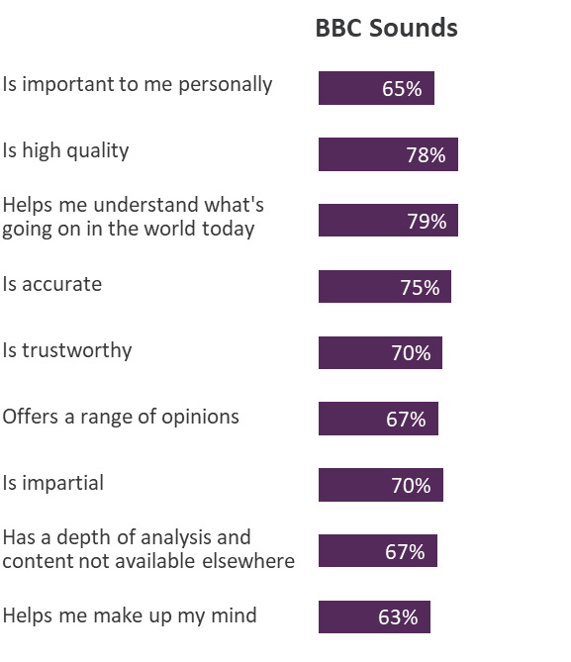
Attributes of Podcast sources – 2022 Online Sample Only* % of regular users rating each source highly (7-10)
Those using BBC Sounds for news rate it highly, particularly for ‘helping me understand what’s going on’ and ‘high quality’
Figure 8.5
Source: Ofcom News Consumption Survey 2022 – ONLINE SAMPLE ONLY
Question: E2. How important is <BRAND> as a source of news to you personally? E3. And to what extent do you think the following statements apply to <BRAND> as a news source? Answer using a scale of 1 to 10
Base: All using each source for news at least weekly 2022 – BBC Sounds=118
*Online only data shown for 2022 W1+W2, as sample size for 2022 W2 combined F2F & online sample is <100
ONLINE SAMPLE ONLY

Slide 56
News consumption via magazines

Slide 57
Magazines used for news nowadays All using magazines for news
Among adults who consume news via magazines, around 1 in 6 claim to read Private Eye and/or The Economist
Figure 9.1
Source: Ofcom News Consumption Survey 2022 – COMBINED F2F & ONLINE sample
Question: D5a. Thinking specifically about magazines, which of the following do you use for news nowadays?
Base: All using magazines for news – 2022 W2*=182, 2020=433, 2019=496, 2018=533
*2022 W1, and 2021, data not shown because face-to-face fieldwork was not possible during Covid-19 pandemic **The Spectator added in 2022
Green/red triangles indicate statistically significant differences between 2022 and 2020 (at 99% confidence level)

Slide 58
Local news

Slide 59
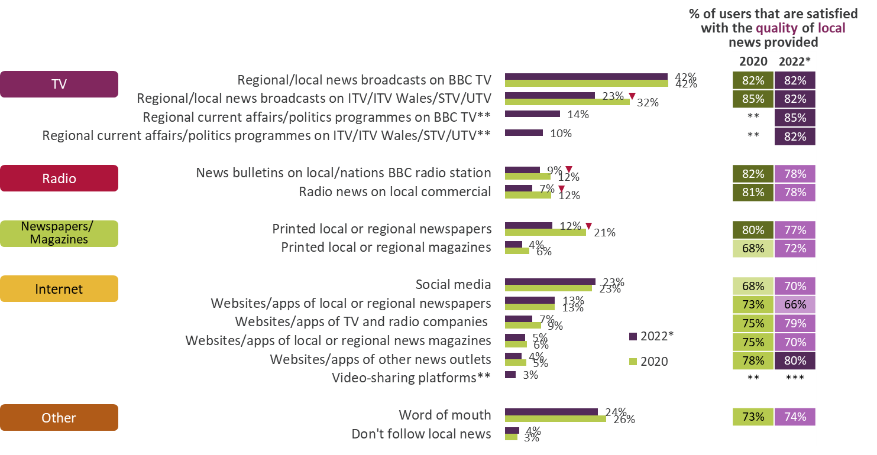
Platforms used to access local news All adults 16+ who follow news
Fewer adults claim to access local news from ITV broadcasts, BBC radio, commercial radio or local newspapers than in 2020
Figure 10.1
Source: Ofcom News Consumption Survey 2022 – COMBINED F2F & ONLINE sample
Question: F8. Thinking particularly about local news, which of the following do you use? Base: All adults 16+ who follow news – 2022 W2*=2708, 2020=4379
Question: F9. How satisfied are you with the quality of the local news available from [source]? Base: All using each source – 2022 W2*=129-1157, 2020=238-1870
*2022 W1, and 2021, data not shown because face-to-face fieldwork was not possible during Covid-19 pandemic **Added in 2022 ***Sample size <100
Green/red triangles indicate statistically significant differences between 2022 and 2020 (at 99% confidence level)

Slide 60
News consumption in the nations

Slide 61
Platforms used for news in general nowadays 2022* – by Nation All adults 16+ in each Nation
TV remains the most used platform for accessing news within each nation
Figure 11.1
2020
75%
75%
75%
68%
67%
58%
62%
53%
46%
44%
46%
39%
40%
34%
31%
31%
6%
4%
3%
5%
43%
38%
43%
41%
32%
32%
32%
29%
35%
33%
33%
22%
9%
10%
7%
3%
6%
6%
8%
4%
3%
3%
6%
15%
Source: Ofcom News Consumption Survey 2022 – COMBINED F2F & ONLINE sample
Question: C1. Which of the following platforms do you use for news nowadays? Base: All adults 16+ 2022 W2* – England=1806, Scotland=344, Wales=337, NI=305
*2022 W1, and 2021, data not shown because face-to-face fieldwork was not possible during Covid-19 pandemic **Internet includes use of social media, podcasts and all other websites/apps accessed via any device ***Other websites/apps includes any non-social media internet source (excluding podcasts)
Green/red triangles indicate statistically significant differences between 2022 and 2020 (at 99% confidence level)

Slide 62
Top sources for news in general nowadays 2022* – by Nation All adults 16+ in each Nation
BBC One is the most used news source in England, Scotland and Wales, and joint most-used alongside ITV/UTV in Northern Ireland, for general news
Figure 11.2
2020
57%
42%
64%
49%
41%
42%
49%
50%
34%
37%
40%
32%
22%
16%
14%
14%
25%
26%
29%
20%
24%
19%
17%
17%
17%
15%
12%
17%
19%
13%
16%
13%
14%
10%
20%
11%
18%
9%
18%
8%
Source: Ofcom News Consumption Survey 2022 – COMBINED F2F & ONLINE sample
Question: D2a-D8a. Thinking specifically about <platform>, which of the following do you use for news nowadays?
Base: All Adults 16+ 2022 W2* – England=1806, Scotland=344, Wales=337, Northern Ireland=305
*2022 W1, and 2021, data not shown because face-to-face fieldwork was not possible during Covid-19 pandemic
Only sources with an incidence of 15%+ in 2022 for the Total sample are shown
Green/red triangles indicate statistically significant differences between 2022 and 2020 (at 99% confidence level)

Slide 63
Top 20 sources for news in general - England % of adults 16+ in England using each source for news nowadays
Fewer adults in England claim to use BBC One, ITV and Google (search) compared to 2020
Figure 11.3
 | 2018 | 2019 | 2020 | 2022*
BBC One | 62% | 58% | 57% | 53%
ITV | 39% | 38% | 41% | 33%
Facebook | 33% | 35% | 34% | 31%
BBC News Channel | 28% | 25% | 22% | 24%
BBC website/app | 25% | 27% | 24% | 23%
Sky News Channel | 24% | 23% | 25% | 22%
Channel 4 | 19% | 18% | 19% | 17%
Twitter | 14% | 17% | 17% | 16%
Instagram | 10% | 15% | 14% | 15%
Daily Mail/Mail on Sunday | 19% | 19% | 18% | 15%
WhatsApp | 10% | 15% | 14% | 15%
Google (search engine) | 19% | 21% | 16% | 13%
BBC Two | 14% | 12% | 12% | 11%
The Guardian/Observer | 11% | 12% | 11% | 10%
BBC Radio 2 | 12% | 12% | 12% | 10%
BBC Radio 4 | 10% | 10% | 9% | 10%
Channel 5 | 11% | 10% | 8% | 8%
BBC Radio 1 | 8% | 9% | 10% | 8%
YouTube website/app | 6% | 6% | 6% | 8%
Local newspapers | 12% | 10% | 9% | 8%
TV channel
Newspaper (print + website/app)
Radio station
Social media
Other website/app
Source: Ofcom News Consumption Survey 2022 – COMBINED F2F & ONLINE sample
Question: D2a-D8a. Thinking specifically about <platform>, which of the following do you use for news nowadays?
Base: All Adults 16+ in England - 2022 W2*=1806, 2020=3171, 2019=3245, 2018=3206
*2022 W1, and 2021, data not shown because face-to-face fieldwork was not possible during Covid-19 pandemic
Green/red triangles indicate statistically significant differences between 2022 and 2020 (at 99% confidence level)

Slide 64
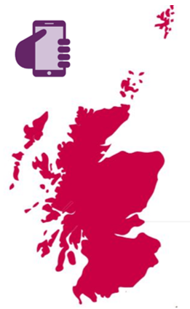
Top 20 sources for news in general – Scotland % of adults 16+ in Scotland using each source for news nowadays
More adults in Scotland use the BBC News Channel and Instagram, while fewer use BBC Scotland compared to 2020
Figure 11.4
 | 2018 | 2019 | 2020 | 2022*
BBC One | 64% | 54% | 42% | 51%
ITV/STV | 54% | 51% | 42% | 45%
Facebook | 33% | 34% | 37% | 38%
Sky News Channel | 24% | 19% | 26% | 26%
BBC News Channel | 17% | 16% | 16% | 25%
Twitter | 11% | 17% | 15% | 20%
BBC website/app | 14% | 15% | 19% | 19%
Instagram | 6% | 9% | 10% | 18%
Channel 4 | 13% | 14% | 13% | 17%
BBC Radio 2 | 10% | 10% | 12% | 16%
BBC Scotland** | - | - | 24% | 15%
Daily Mail/Mail on Sunday | 8% | 9% | 9% | 15%
Google (search engine) | 7% | 13% | 14% | 14%
The Guardian/Observer | 9% | 9% | 10% | 13%
BBC Radio Scotland | 8% | 8% | 10% | 12%
WhatsApp | 7% | 11% | 9% | 12%
Daily Record/Sunday Mail*** | - | - | - | 12%
BBC Two | 10% | 10% | 7% | 12%
Bauer local commercial radio** | - | - | 13% | 11%
YouTube website/app | 2% | 5% | 6% | 10%
TV channel
Newspaper (print + website/app)
Radio station
Social media
Other website/app
Any BBC TV
2022* | 62%
2020 | 56%
2019 | 58%
2018 | 69%
Source: Ofcom News Consumption Survey 2022 – COMBINED F2F & ONLINE sample
Question: D2a-D8a. Thinking specifically about <platform>, which of the following do you use for news nowadays?
Base: All Adults 16+ in Scotland - 2022 W2*=344, 2020=541, 2019=551, 2018=540
*2022 W1, and 2021, data not shown because face-to-face fieldwork was not possible during Covid-19 pandemic
**Added in 2022 ***Website/app added in 2022
Green/red triangles indicate statistically significant differences between 2022 and 2020 (at 99% confidence level)

Slide 65
Top 20 sources for news in general - Wales % of adults 16+ in Wales using each source for news nowadays
More adults in Wales use the BBC News Channel, Twitter and TikTok compared to 2020
Figure 11.5
 | 2018 | 2019 | 2020 | 2022*
BBC One | 68% | 57% | 64% | 61%
ITV/ITV WALES | 45% | 45% | 49% | 43%
Facebook | 35% | 38% | 40% | 42%
Sky News Channel | 26% | 28% | 29% | 32%
BBC News Channel | 19% | 14% | 14% | 26%
Instagram | 6% | 8% | 20% | 23%
Twitter | 13% | 11% | 12% | 22%
BBC Radio 2 | 14% | 15% | 19% | 19%
Channel 4 | 12% | 11% | 16% | 16%
WhatsApp | 7% | 7% | 11% | 16%
BBC website/app (incl. Welsh language version) | 22% | 18% | 17% | 16%
Daily Mail/Mail on Sunday | 15% | 20% | 18% | 14%
BBC Two | 13% | 7% | 10% | 13%
Channel 5 | 7% | 7% | 12% | 13%
TikTok** | - | - | 1% | 12%
Google (search engine) | 10% | 13% | 9% | 12%
BBC Radio 4 | 14% | 8% | 13% | 11%
Western Mail/ Wales on Sunday/ Wales Online*** | - | - | - | 10%
Google News | 2% | 5% | 6% | 7%
BBC Parliament | 3% | 3% | 3% | 7%
TV channel
Newspaper (print + website/app)
Radio station
Social media
Other website/app
Source: Ofcom News Consumption Survey 2022 – COMBINED F2F & ONLINE sample
Question: D2a-D8a. Thinking specifically about <platform>, which of the following do you use for news nowadays?
Base: All Adults 16+ in Wales - 2022 W2*=337, 2020=456, 2019=475, 2018=458
*2022 W1, and 2021, data not shown because face-to-face fieldwork was not possible during Covid-19 pandemic **TikTok added in 2020 ***Wales Online added in 2022
Green/red triangles indicate statistically significant differences between 2022 and 2020 (at 99% confidence level)

Slide 66
Top 20 sources for news in general – Northern Ireland % of adults 16+ in NI using each source for news nowadays
More than half of adults in Northern Ireland claim to use BBC One and ITV/UTV, while one in three use Facebook
Figure 11.6
 | 2018 | 2019 | 2020 | 2022*
BBC One | 52% | 58% | 49% | 56%
ITV/UTV | 63% | 59% | 50% | 54%
Facebook | 35% | 35% | 32% | 34%
Sky News Channel | 21% | 24% | 20% | 23%
Cool FM | 18% | 21% | 20% | 18%
BBC website/app | 15% | 10% | 17% | 17%
BBC Radio Ulster/Foyle | 22% | 25% | 18% | 16%
Channel 4 | 12% | 16% | 13% | 16%
BBC News Channel | 11% | 16% | 14% | 15%
Instagram | 6% | 6% | 11% | 13%
Twitter | 11% | 13% | 17% | 13%
WhatsApp | 9% | 11% | 13% | 13%
BBC Radio 1 | 12% | 15% | 8% | 13%
Belfast Telegraph/Sunday Life*** | - | - | - | 11%
BBC Two | 5% | 6% | 6% | 11%
Daily Mail/Mail on Sunday | 11% | 13% | 8% | 10%
U105** | - | - | - | 10%
Daily/Sunday Mirror | 5% | 8% | 8% | 10%
Google (search engine) | 10% | 8% | 13% | 8%
RTE Channels/Virgin Media One/TG4 | 8% | 8% | 9% | 8%
TV channel
Newspaper (print + website/app)
Radio station
Social media
Other website/app
Source: Ofcom News Consumption Survey 2022 – COMBINED F2F & ONLINE sample
Question: D2a-D8a. Thinking specifically about <platform>, which of the following do you use for news nowadays?
Base: All Adults 16+ in Northern Ireland - 2022 W2*=305, 2020=408, 2019=420, 2018=414
*2022 W1, and 2021, data not shown because face-to-face fieldwork was not possible during Covid-19 pandemic **U105 added in 2022 ***Website/app added in 2022
Green/red triangles indicate statistically significant differences between 2022 and 2020 (at 99% confidence level)

Slide 67
Single most important source for news in general 2022* – by Nation All adults 16+ in each Nation using TV/Newspapers/Radio/Internet/Magazines for news
BBC One is the single most important news source across Wales, England, Scotland, and joint most important with ITV/UTV in Northern Ireland.
Figure 11.7
2020
23%
18%
34%
22%
10%
17%
14%
26%
6%
5%
4%
3%
7%
9%
7%
9%
5%
4%
2%
1%
7%
8%
6%
1%
4%
2%
1%
2%
3%
1%
3%
1%
1%
1%
2%
3%
1%
1%
2%
1%
2%
2%
1%
1%
Source: Ofcom News Consumption Survey 2022 – COMBINED F2F & ONLINE sample
Question: E1a. Looking at all the sources of news you have just said that you use, which one is most important to you?
Base: All adults 16+ using TV/Newspapers/Radio/Internet/Magazines for news 2022 W2* – England=1727, Scotland=326, Wales=325, Northern Ireland=287
*2022 W1, and 2021, data not shown because face-to-face fieldwork was not possible during Covid-19 pandemic
Only sources with an incidence of 2%+ in 2022 for the Total sample are shown
Green/red triangles indicate statistically significant differences between 2022 and 2020 (at 99% confidence level)

Slide 68
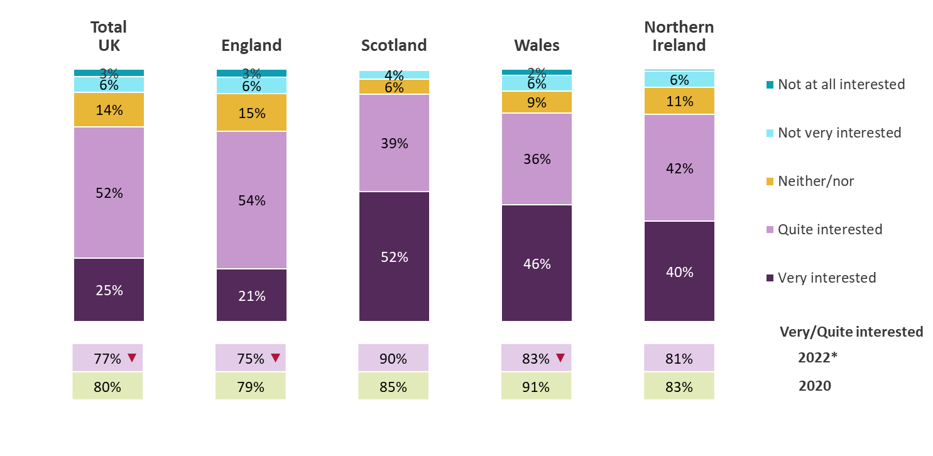
Level of interest in news about own nation/region 2022* – by Nation All adults 16+ who follow news
Adults in Scotland and Wales are the most likely to say they are ‘very interested’ in news about their nation, whereas those in England and Northern Ireland) are more likely to be ‘quite interested’ in their region/nation
Figure 11.8
Source: Ofcom News Consumption Survey 2022 – COMBINED F2F & ONLINE sample
Question: F3. How interested are you in news about <NATION/REGION>?
Base: All adults 16+ who follow news 2022 W2* - Total=2708, England=1758, Scotland=332, Wales=329, Northern Ireland=289
*2022 W1, and 2021, data not shown because face-to-face fieldwork was not possible during Covid-19 pandemic
Green/red triangles indicate statistically significant differences between 2022 and 2020 (at 99% confidence level)

Slide 69
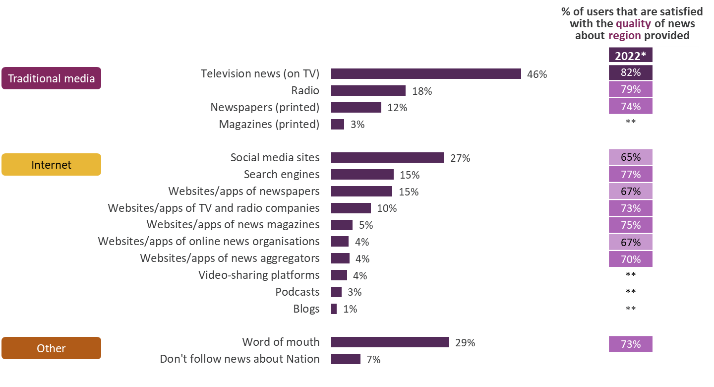
Platforms used to access news about own region in England 2022* All adults 16+ who follow news
TV is the most used platform for accessing regional news in England. Satisfaction with the quality of news is generally higher for the traditional media channels compared to social media sites
Figure 11.9
Source: Ofcom News Consumption Survey 2022 – COMBINED F2F & ONLINE sample
Question: F4. Thinking particularly about your source of news for what is going on in your region, which of the following do you use? Base: All adults 16+ who follow news 2022 W2* - England=1758
F5. How satisfied are you with the quality of the news about your region available from [source]? Base: All using each source – 2022 W2*=103-804 **sample size <100
*2022 W1 data not shown because face-to-face fieldwork was not possible during Covid-19 pandemic
England not asked this question pre-2022, so no comparable data from previous surveys

Slide 70
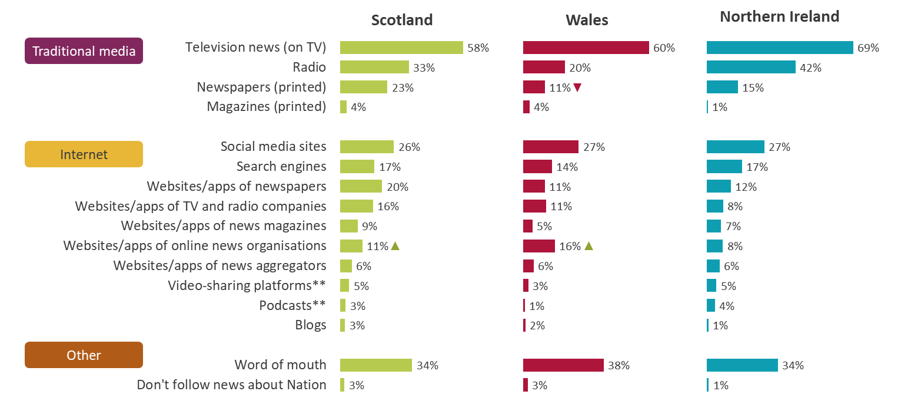
Platforms used to access news about own nation 2022* – by Nation All adults 16+ who follow news
TV is the most popular platform for accessing news about the nations, especially in Northern Ireland where radio is also particularly popular
Figure 11.10
Source: Ofcom News Consumption Survey 2022 – COMBINED F2F & ONLINE sample
Question: F4. Thinking particularly about your source of news for what is going on in NATION, which of the following do you use?
Base: All adults 16+ who follow news 2022 W2* - Scotland=332, Wales=329, Northern Ireland=289
*2022 W1, and 2021, data not shown because face-to-face fieldwork was not possible during Covid-19 pandemic ** Added in 2022
Green/red triangles indicate statistically significant differences between 2022 and 2020 (at 99% confidence level)

Slide 71
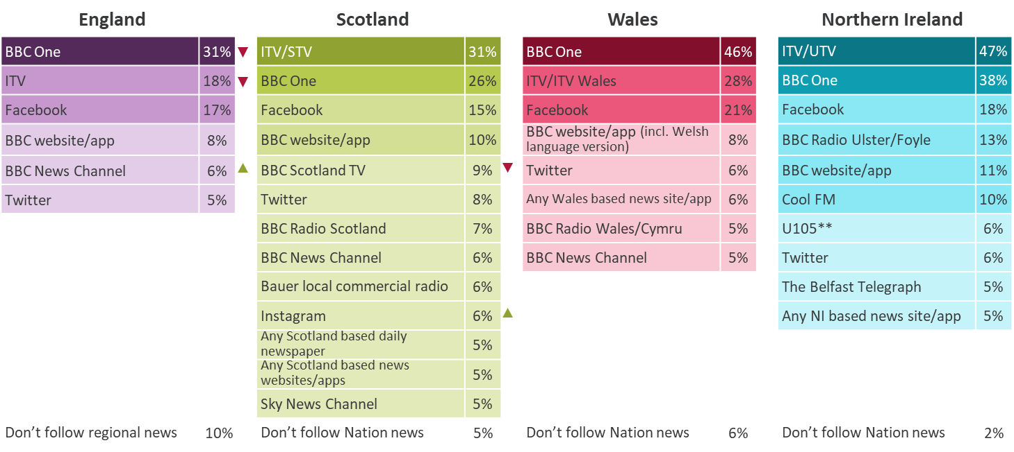
Sources used to access news about own nation/region 2022* All adults 16+ using TV/Newspapers/Radio/Internet/Magazine for news
BBC One is the most used news source in England and Wales for accessing news about the region/Nation, whereas ITV/STV is most used in Scotland and ITV/UTV is the most used in Northern Ireland
Figure 11.11
Source: Ofcom News Consumption Survey 2022 – COMBINED F2F & ONLINE sample
Question: F6. From which of the following sources do you get news about what is going on in your NATION/REGION nowadays?
Base: All adults 16+ using TV/Newspapers/Radio/Internet/Magazine for news 2022 W2* - England=1727, Scotland=326, Wales=325, Northern Ireland=287
*2022 W1, and 2021, data not shown because face-to-face fieldwork was not possible during Covid-19 pandemic **U105 added in 2022
Only sources with an incidence of 5%+ in each Nation are shown.
Green/red triangles indicate statistically significant differences between 2022 and 2020 (at 99% confidence level)

Slide 72
Current affairs

Slide 73
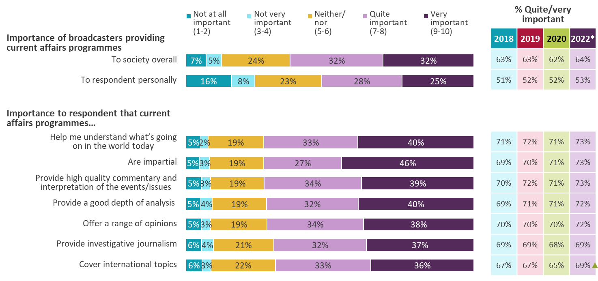
Attitudes to current affairs programmes All adults 16+
64% of adults feel it is important ‘to society overall’ that broadcasters provide current affairs programmes, while just over half feel it is important ‘to them personally’
Figure 12.1
Source: Ofcom News Consumption Survey 2022 – COMBINED F2F & ONLINE sample
Question: H1/H2. On a scale of 1 -10 where 1 means not at all important and 10 means extremely important, how important for [you personally / society overall] is it that broadcasters provide current affairs programmes? H3. How important for you personally is it that current affairs programmes…
Base: All adults 16+ - 2022 W2*=2792, 2020=4576, 2019=4691, 2018=4618
*2022 W1, and 2021, data not shown because face-to-face fieldwork was not possible during Covid-19 pandemic
Green/red triangles indicate statistically significant differences between 2022 and 2020 (at 99% confidence level)

Slide 74
How teens aged 12-15 consume news

Slide 75
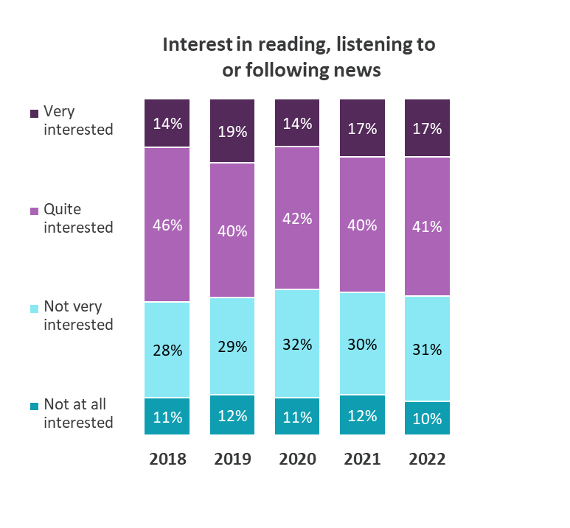
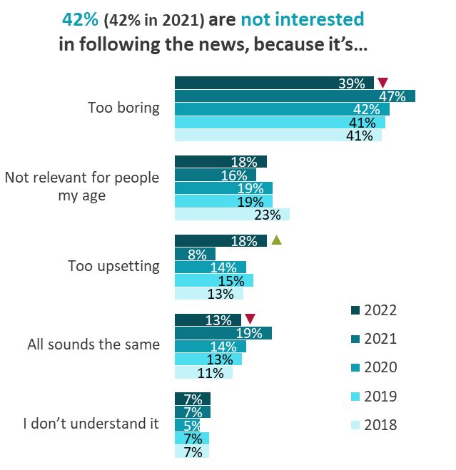
Overall interest in following the news All teens aged 12-15
As in previous years, just under six in ten 12-15s claim to be very or quite interested in following the news. Being ‘too boring’ remains the key reason for a lack of engagement (although this has decreased since 2021)
Figure 13.1
Source: Ofcom Teen News Consumption Survey 2022
Question: B1. How interested are you in reading, watching, listening to or following news? Base: All teens aged 12-15 – 2022=1001, 2018-2021=1000-1010
Question: B2. Why are you not interested in reading, watching, listening to or following news? Base: All not interested in following news – 2022=408, 2018-2021=395-421
Green/red triangles indicate statistically significant differences between 2022 and 2021 (at 95% confidence level)

Slide 76
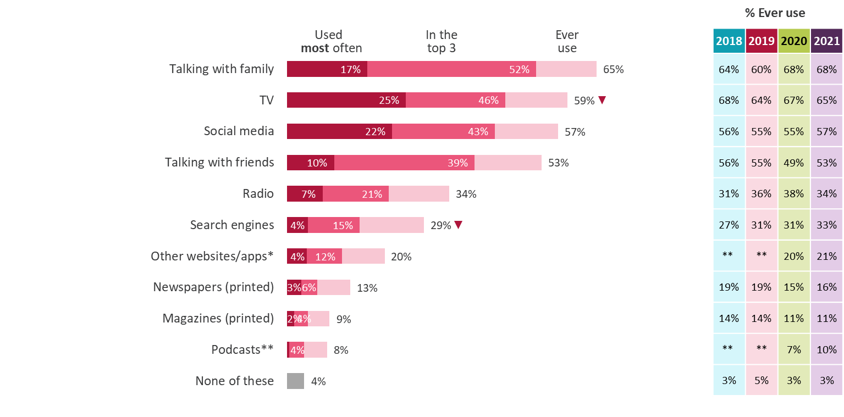
All platforms used for news nowadays All teens aged 12-15
Talking to family and watching TV remain the most common ways to find out about news among 12-15s, followed by social media and talking to friends
Figure 13.2
Source: Ofcom Teens News Consumption Survey 2022
Question: C1. Here is a list of different ways you can find out about or get updates on news stories. Which of these ways do you ever use?
C2. And which of these ways do you use the most to get updates on news stories? Base: All teens aged 12-15 – 2022=1001, 2018-2021=1000-1010
*Other websites/apps includes any internet source, excluding social media/search engines/podcasts **Podcasts asked about as a separate category starting in 2020
Green/red triangles indicate statistically significant differences between 2022 and 2021 (at 95% confidence level)

Slide 77
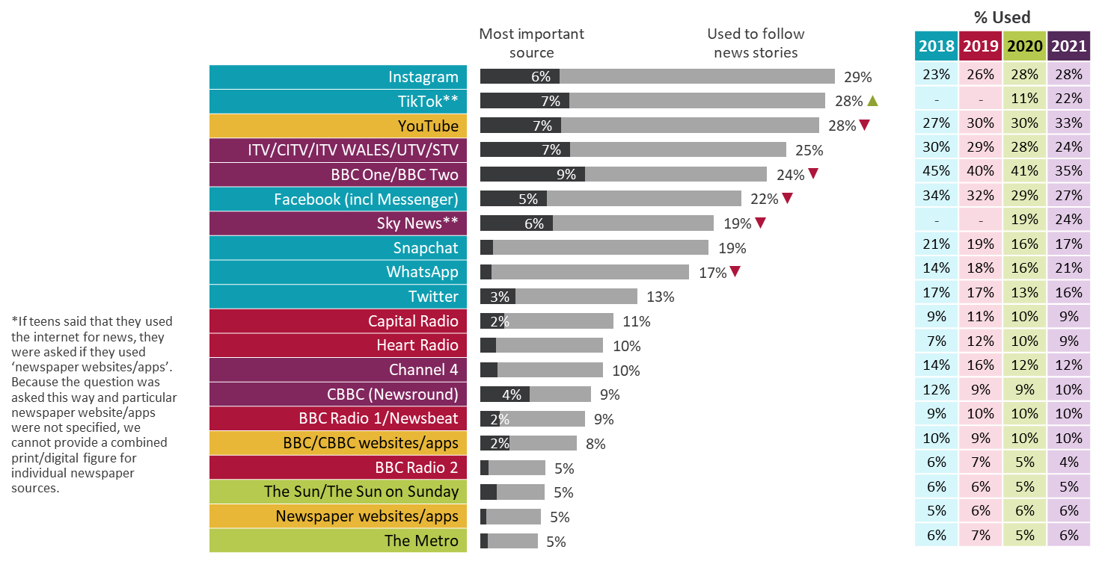
Top 20 news sources All teens aged 12-15
Use of TikTok has increased making it one of the top three most used sources of news across all platforms. Meanwhile many of the top sources, particularly BBC One/Two, have seen decreases since 2021
Figure 13.3
TV Channel
Social media
Radio station
Website/app
Newspaper (print only)*
Source: Ofcom Teens News Consumption Survey 2022
Question: D1. Which, if any, of the following do you use to read, watch, listen to or follow news stories?
E1a. Here is a list of all the news sources that you say you use. Which ONE of these is the most important news source to you?
Base: All teens aged 12-15 – 2022=1001, 2018-2020=1000-1010 **Added in 2020
Green/red triangles indicate statistically significant differences between 2022 and 2021 (at 95% confidence level)

Slide 78
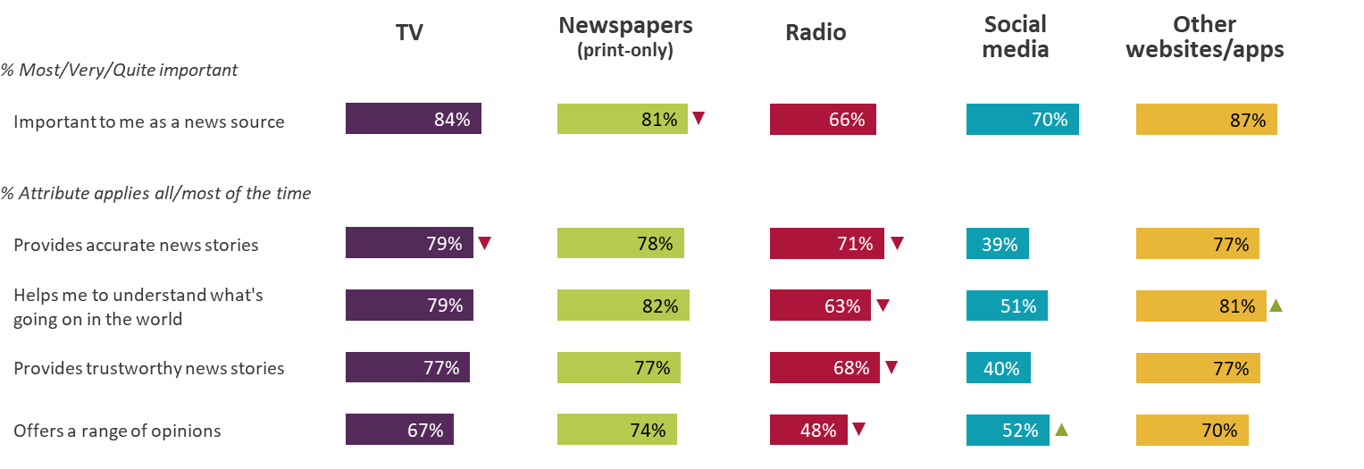
Attributes of news platforms - 2022 Ratings from aged 12-15 using each platform for news
Users of Other websites/apps, TV and Newspapers tend to give high ratings across the majority of the attributes. Scores for Radio have decreased since 2021, while social media scores remain comparatively low
Figure 13.4
Source: Ofcom Teens News Consumption Survey 2022
Question: E2. You will now see all of the other news sources that you use. I would like you to tell me how important each one is to you.
E3. You will now see a list of statements. I would like you to tell me how often each of these statement applies to each of the different news sources
Base: All ratings by aged 12-15 who use each platform for news 2022 – TV=900, Newspapers=310, Radio=533, Social media=1739, Other websites/apps=234
Green/red triangles indicate statistically significant differences between 2022 and 2021 (at 95% confidence level)

Slide 79
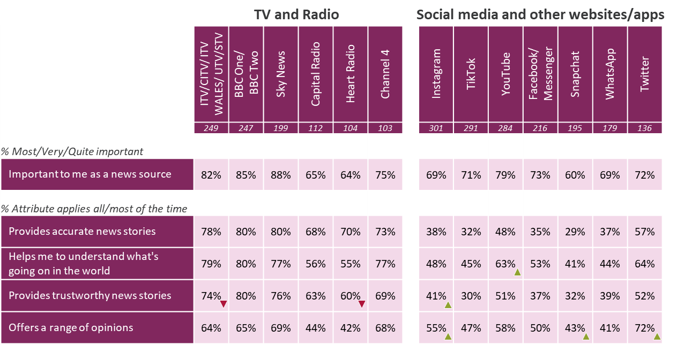
Attributes of news sources – 2022 All aged 12-15 using each source for news
BBC One/Two, Sky News and ITV tend to receive the highest ratings from their users across most of the attributes. TikTok, one of the top sources by reach, is only trusted by 3 out of 10 who use it for news
Figure 13.5
Source: Ofcom Teens News Consumption Survey 2022
Question: E2. You will now see all of the other news sources that you use. I would like you to tell me how important each one is to you.
E3. You will now see a list of statements. I would like you to tell me how often each of these statement applies to each of the different news sources
Base: All aged 12-15 who use each source for news (bases shown above, only sources used by 100+ respondents included)
Green/red triangles indicate statistically significant differences between 2022 and 2021 (at 95% confidence level)

Slide 80
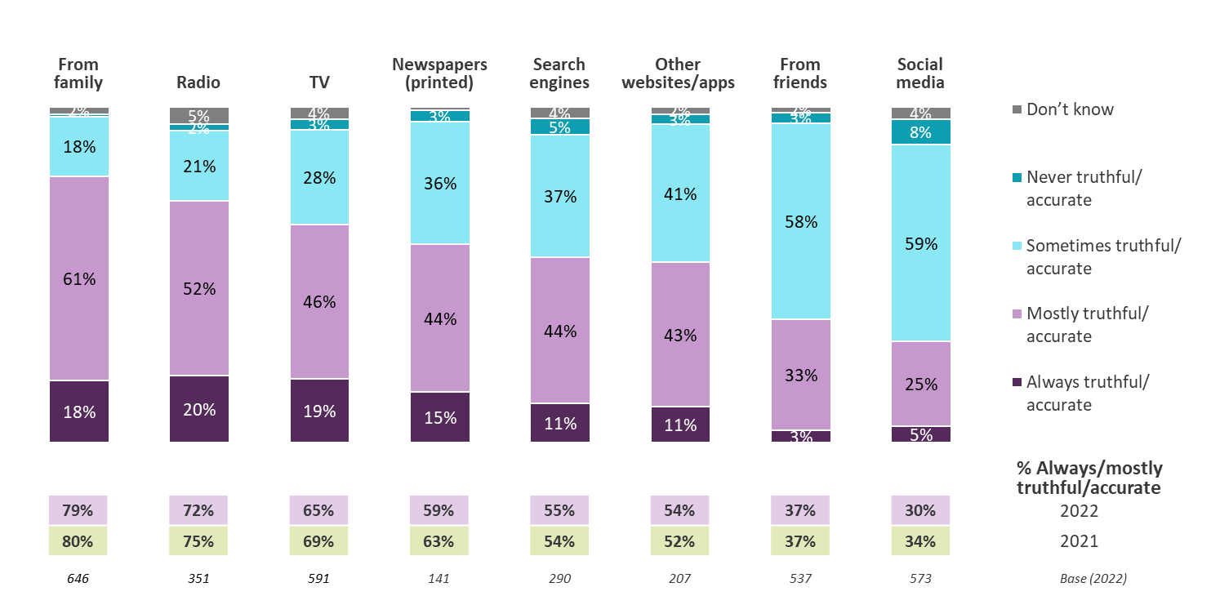
Perceived accuracy of news stories from each platform All aged 12-15 who use each platform for news
Family, radio and TV are considered the most accurate/truthful sources, while social media and friends are considered least truthful
Figure 13.6
Source: Ofcom Teens News Consumption Survey 2022
Question: C4. Which one of these answers best describes the news that you read or see?
C5/6. When you hear about news stories from your [friends / family], how likely do you think the stories are to be accurate?
Base: All aged 12-15 who use each platform for news (bases shown above)
Green/red triangles indicate statistically significant differences between 2022 and 2021 (at 95% confidence level)

Slide 81
Appendix – Industry currencies and methodology

Slide 82
Industry currencies used in the report
BARB (Broadcasters’ Audience Research Board) is the official industry currency for TV consumption. It uses a continuous panel of approximately 5,300 UK homes and tracks television viewing among all people aged 4+ in these homes using meters attached to every working television set in the home.

Slide 83
News Consumption Survey – Adult methodology
From December 2017 until March 2020, Jigsaw Research conducted a mixed methodology approach, combining online and face-to-face interviews. However, during the last two years of research, Jigsaw were unable to do this consistently, due to the Covid-19 pandemic.
Since online methodologies tend to underrepresent low/non internet users, Jigsaw conducted a combination of online and telephone interviews during November/December 2020, March/April 2021 and November/December 2021, to ensure that these groups had the opportunity to express their views. In March/April 2022, Jigsaw reverted back to the preferred methodology of conducting online and face-to-face interviews, to be consistent with previous and future years.
In total, the face-to-face survey achieved 1,086 interviews, with the nations over-represented during fieldwork. This data has been weighted to correct for this over-representation, with weights being applied by age, gender and socio-economic group (SEG) within nation, to provide a representative view of all UK adults. The online (1,706 interviews) and face-to-face data has been combined to provide a snapshot of opinion across both methodologies during March/April 2022. The 1,717 online interviews collected in November/December 2021 have not been included in the combined data.
We compared the online data collected in November/December 2021 with the online data collected in March/April 2022 and while we did observe some statistically significant differences there were no indications of strong seasonable effects. We therefore took the decision that a combined face-to-face and online dataset based on March/April 2022 data alone was preferable to a dataset based on online data from November/December 2021 and March/April 2022 and face-to-face data from March/April only, as less weighting was required.
To ensure that any trend data within this publication is comparable, we have also decided to publish the online data separately, as we did in 2021. The 3,423 online interviews have been weighted by age, gender, nation/region, working status and ethnicity to ensure they are representative of ‘recent’ internet users, as found in the ONS Internet Users research (published on 6th April, 2020).

Slide 84
News Consumption Survey – Adult & Teen methodology
Statistically significant differences year-on-year are shown at a 99% confidence level for the online and face-to-face data and a 95% confidence level for the online (only) data.
The survey has approximately 200 codes for different potential sources for news, as well as the option to allow respondents to nominate their own sources which yields a further 800 or so, including regional sources. This gives us a bottom-up measure of what people consider they use for news (about their nation, the UK, and internationally) and will not necessarily include every possible outlet. The survey therefore provides a granular range of news sources. These individual news sources are then aggregated into various groups or “nets” relating to their owner or publisher.
This is a recall-based survey. As such, it is likely to provide somewhat different results to other types of measurement. In particular, it may underestimate some online news consumption activity. It is likely to be harder for respondents to recall ad-hoc online news consumption compared to, say, the purchase of a newspaper or the watching of an evening television bulletin. On the other hand, respondents show through such surveys which news sources resonate with them.
The methodology used for the 12-15s study is largely unchanged over the last 5 years.
In total, 500 interviews from 5th November – 6th December 2021 have been combined with 501 interviews from 6th March – 4th April 2022.
Quotas were set on age, gender, socio-economic group (SEG) and nation to ensure the sample was representative of the UK and the data has also been weighted on age, gender, SEG and nation. Statistically significant differences year-on-year are shown at a 95% confidence level.
Each wave of fieldwork was undertaken in three stages:
Stage 1: We targeted parents of 12-15 year olds, using an online panel.
Stage 2: Parents were screened to ensure we recruited a representative sample of participants.
Stage 3: The parent asked their (qualifying) teen to complete the rest of the questionnaire.

